Slide 1

Wireless Networking
Ambuj Varshney
ambujv@nus.edu.sg
Notes:
++ Thank you for inviting me to give this talk
++ In this talk, I will present a pathway that can enable us to make wireless embedded systems ubiquitous. I will describe my previous research efforts that tackle the critical challenges that limit the growth of wireless embedded systems. These are related to the growing energy asymmetry that exists between sensing, computation and communication blocks on these platforms.
++ Finally, I will conclude my talk by covering the research agenda that I would like to work on as a faculty member.

Slide 2
Roadmap of the lecture today
Quick Recap
Antenna Continued
Line of Sight and Non Line of Sight
Modulation Basics

Slide 3
Quick Recap
Notes:
++ Over the past few years, I have designed several backscatter and beyond backscatter systems that precisely overcome these critical challenges that have limited the widespread deployment of backscatter on IoT devices.
++ The research vision that I have pursued and would like to pursue as a faculty member is to enable a massive deployment of IoT devices by bridging the energy asymmetry between sensing, computation and communication blocks by designing novel platforms and communication mechanisms. I am going to describe some of my research contributions next.

Slide 4
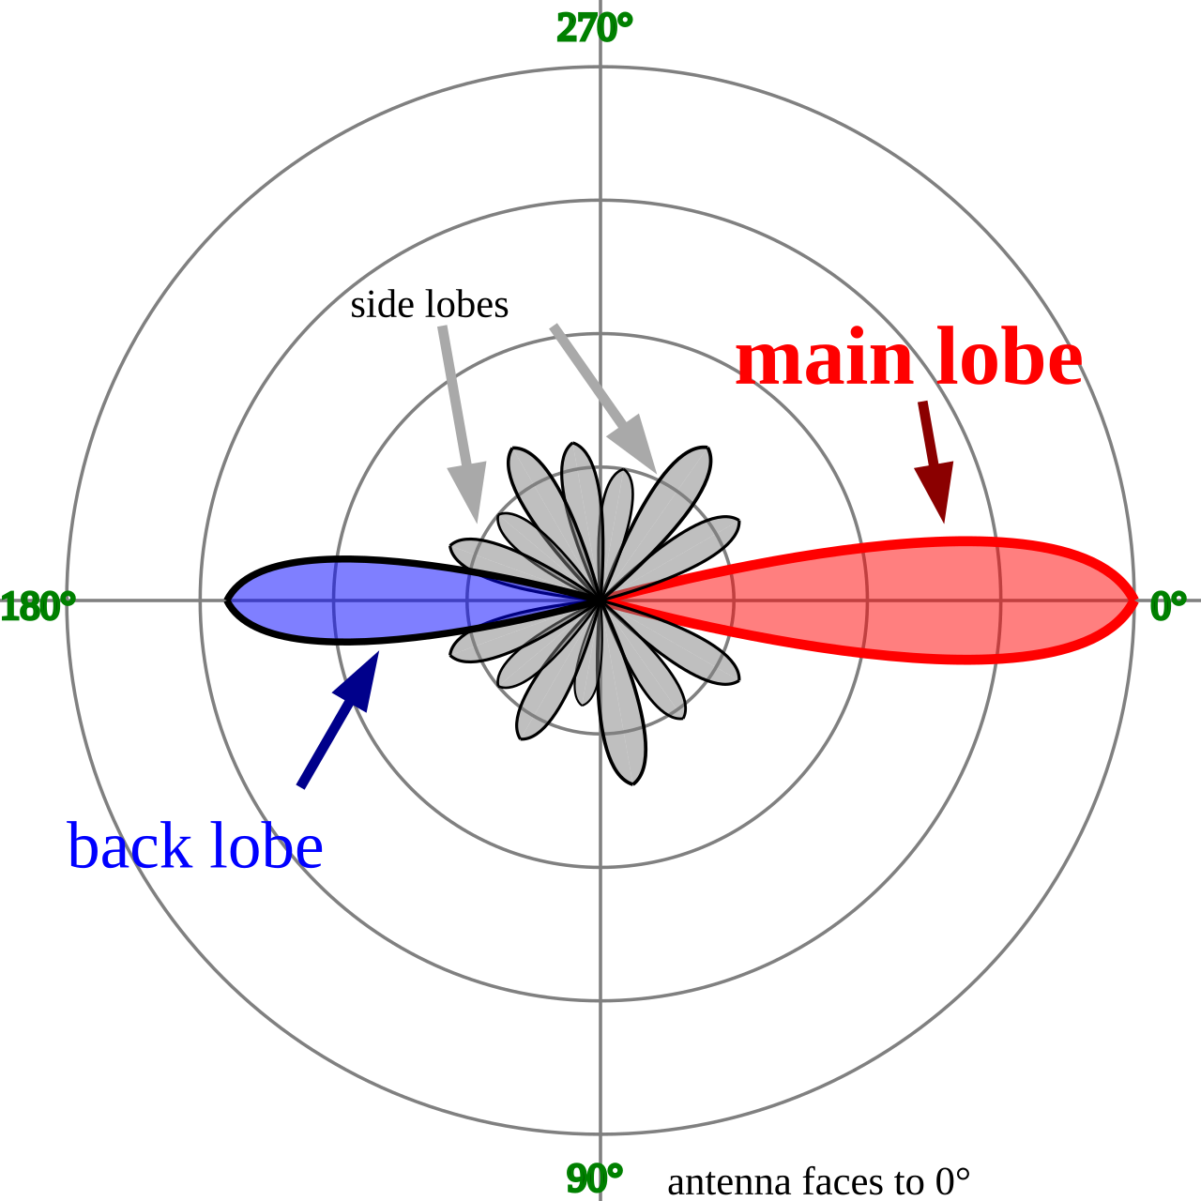
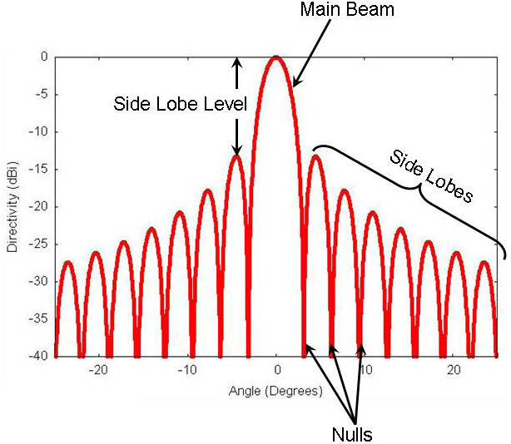
Radiation pattern of the antenna
Radiation pattern of an antenna is a graphical representation of the relative strength of the radiated power in various directions. It illustrates how an antenna distributes energy in space
The radiation pattern is represented as a polar or rectangular plot
Helps you understand the nature of antenna: isotropic, directional or omnidirectional. Helps optimize the placement of wireless devices
Polar Radiation Plot
Rectangular Radiation Plot

Slide 5
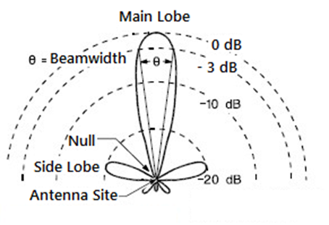
Understanding the antenna beamwidth
Main lobe of radiation pattern is where maximum radiation occurs
Antenna beamwidth is the angular separation between the points on the radiation pattern where the power drops to half of its maximum value, commonly known as the -3 dB points
Beamwidth defines the directivity and coverage area of the antenna.
Courtesy: EverythingRF

Slide 6
Beamwidth and antenna gain
What are the implications of the narrow beamwidth?
Higher directivity
Longer range
Gain? Results in longer range
Suitable for point-to-point links
What are the implications of the broader beamwidth?
Covers larger area, smaller directivity
Smaller range
Gain? Lesser gain
Suitable for broadcast applications

Slide 7


Non-line of sight propagation of radio waves
Transmitter and receiver are not kept in line of sight
Radio waves encounter obstacles, may go through walls, buildings
Much more applicable to read world environment and deployments
Significantly impacts the communication range and reliability

Slide 8
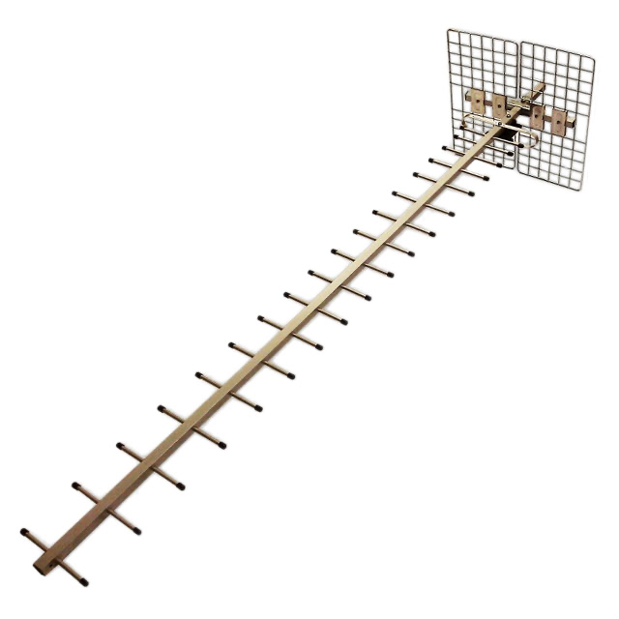
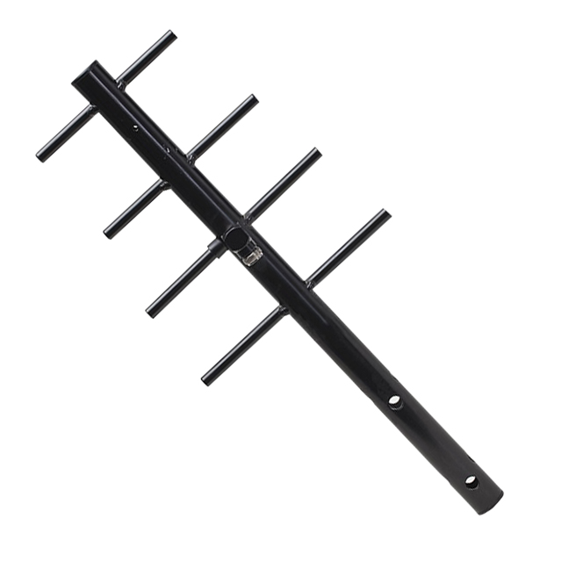
Revisiting antennas and their gain
Yagi-uda antenna. It has a very high gain. The gain and directionality increases with the number of antenna elements.
Antenna Gain: 23 dBi
Antenna Gain: 8 dBi

Slide 9
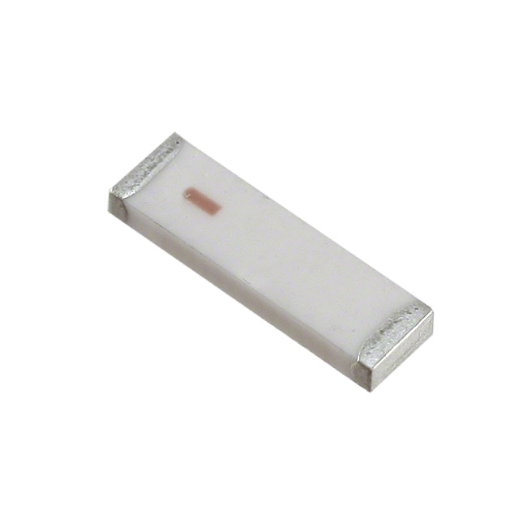
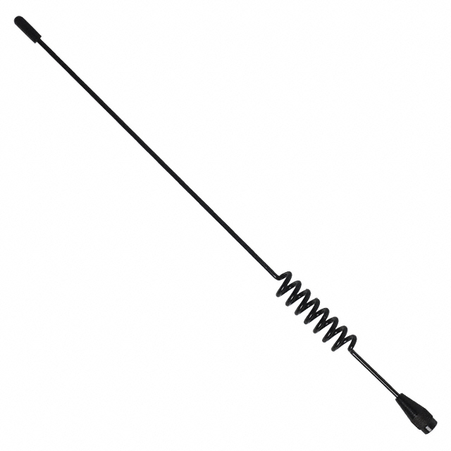
Revisiting antennas and their gain
Chip antenna makes sacrifice due to smaller form factor and hence the least gain. Whip antenna has less directionality than Yagi-uda antenna.
Antenna Gain: -1 dBi
Antenna Gain: 3.8 dBi

Slide 10
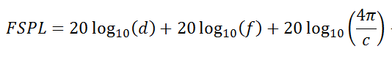
Basics of wireless communication and networking
Free space path loss (FSPL or FSL): The loss of power encountered by signal as it transmits from the transmitter to the receiver
d is the distance between the transmitter and receiver antennas (in meters),
f is the frequency of the signal (in Hertz),
c is the speed of light in a vacuum

Slide 11
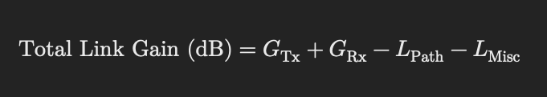
Total link gain in wireless communication
Total link gain represents the net amplification and attenuation of the electromagnetic signal along the communication path
What are the factors that are included in the total link gain?
Antennas
Free space path loss
And other system component
G_{tx} = Transmitter antenna gain (dB)
G_{rx}= Receiver antenna gain (dB)
L_{Path} = Path loss (dB), including free-space loss
L_{Misc}= Miscellaneous losses (dB), such as atmospheric losses, cable losses, and interference effects

Slide 12
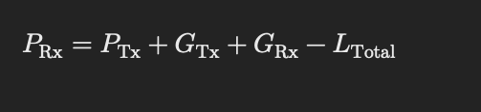
Link Budget and Total Link Gain
Calculation that takes into account all gains and losses to determine received signal strength of wireless signal in a communication system
Total Link Budget (P_{rx}) = P_{tx} + Total Link Gain

Slide 13
Revisiting dB, dBm, and dBi, and operations
Let us recall the definition of all three of them:
dB (Decibel):
Logarithmic unit for ratios (gain/loss).
Dimensionless (e.g., 3 dB amplifier gain).
dBm:
Absolute power referenced to 1 mW.
0 dBm = 1 mW (e.g., 20 dBm = 100 mW).
dBi:
Antenna gain relative to an isotropic radiator.
Measures directionality (e.g., 5 dBi = 5 dB over isotropic).

Slide 14

Adding and Subtracting dB, dBm, and dBi
✅ Adding dB values:
• If two components contribute gain or loss, we add their dB values
• Example: Two amplifiers with +10 dB and +5 dB gain
✅ Adding dBi to dBm to get EIRP:
• Effective Isotropic Radiated Power (EIRP) is the total output power including antenna gain
• Example:
• Transmit Power = 20 dBm
• Antenna Gain = 8 dBi
EIRP = 20 + 8 = 28 dBm

Slide 15
Adding and Subtracting dB, dBm, and dBi
✅ Subtracting Losses (dB) from Power (dBm)
Losses (such as cable loss, free-space path loss) can be subtracted from the transmitted power.:
Transmit Power = 30 dBm, Antenna Gain = 5 dBi, Cable Loss = 2 dB, Path Loss = 50 dB
Receiver Antenna Gain = 3 dBi
Prx= 30 + 5 - 2 - 50 + 3 = -14 dBm
✅ Subtracting dBm values to get dB difference
If you want to compare two power levels, you can subtract them in dB:
Delta P = P₁ - P₂
Power at point A = 20 dBm, Power at point B = 5 dBm
Difference in power: 20 - 5 = 15 dB
This means B has 15 dB less power than A.

Slide 16
Adding and Subtracting dB, dBm, and dBi
❌ You cannot add dBm values directly
• Example (incorrect):
10 dBm + 20 dBm = 30 dBm
Why? Because dBm represents absolute power, and logarithmic values cannot be added directly.
Instead, convert to linear scale:
10 dBm = 10 mW
20 dBm = 100 mW
Total Power = 110 mW
Convert back to dBm: Ptotal = 10log₁₀(110) = 20.4 dBm

Slide 17
Adding and Subtracting dB, dBm, and dBi
Do:
Use dB ± dBm for power adjustments (e.g., Tx power + antenna gain).
Subtract dBm - dBm to compute ratios (e.g., SNR calculations).
Add dBi only to dBm for EIRP.
Don’t:
Add dBm + dBm or dBi + dBi.
Mix units without context (e.g., dBi + dBm ≠ dB).
Why:
dB = ratio; dBm = absolute power; dBi = directional gain.
Antenna gains are standalone; powers require linear conversion.

Slide 18
Adding and Subtracting dB, dBm, and dBi
dBm + dBm:
Invalid! Powers require linear addition (e.g., 20 dBm + 20 dBm ≠ 40 dBm).
dBi + dBi:
Antenna gains are not additive (e.g., 3 dBi + 3 dBi ≠ 6 dBi).
Mismatched Contexts:
E.g., Adding Rx antenna gain (dBi) directly to Tx power (dBm) without path loss

Slide 19
Wireless link quality and reliability
Link reliability metrics quantify the quality and stability of wireless links
Wireless links are inherently unstable due to interference, multipath fading, and mobility. Reliable communication requires choosing links that offer consistent performance. These metrics aid in designing robust protocols for routing, load balancing, and link adaptation.
Helps in routing decisions, optimizing network performance, and improving communication reliability among other uses
From application perspective, no buffering, less latency etc

Slide 20
Wireless link quality and reliability
Important link quality metrics that we consider in wireless networking:
Packet Delivery Ratio (PDR): Ratio of received packets to transmitted packets
Bit Error Rate (BER): Measures the number of bit errors per unit time
Signal-to-Noise Ratio (SNR): Higher SNR indicates better link quality
Expected Transmission Count (ETX): Predicts the number of transmissions required for successful delivery

Slide 21
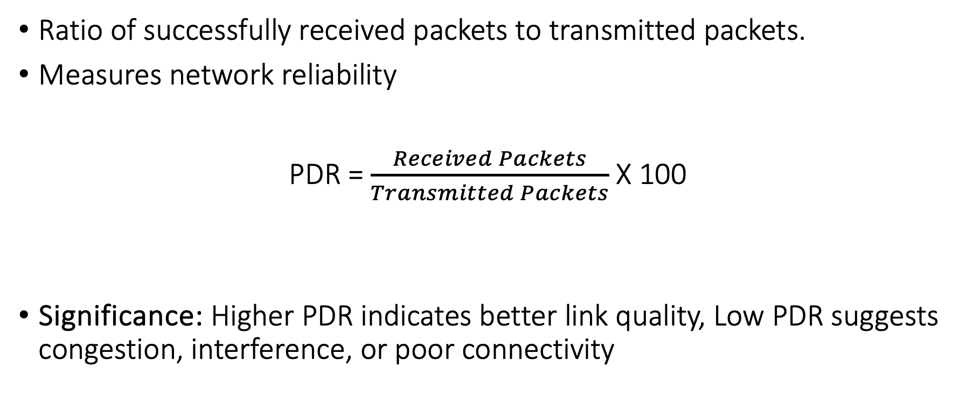
Packet Delivery Ratio (PDR)
Ratio of successfully received packets to transmitted packets.
Measures network reliability
PDR = $\frac{Received Packets}{Transmitted Packets}$ X 100
Significance: Higher PDR indicates better link quality, Low PDR suggests congestion, interference, or poor connectivity

Slide 22
Examples
Question: A sensor node transmits 1000 packets, and the receiver successfully gets 900? What is the PDR?

Slide 23
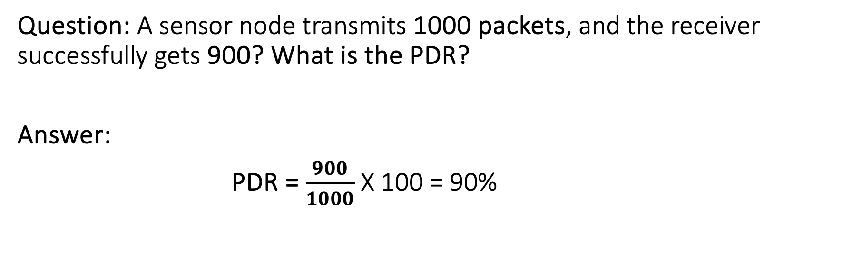
Examples
Question: A sensor node transmits 1000 packets, and the receiver successfully gets 900? What is the PDR?
Answer:
PDR = $\frac{900}{1000}$ X 100 = 90%

Slide 24
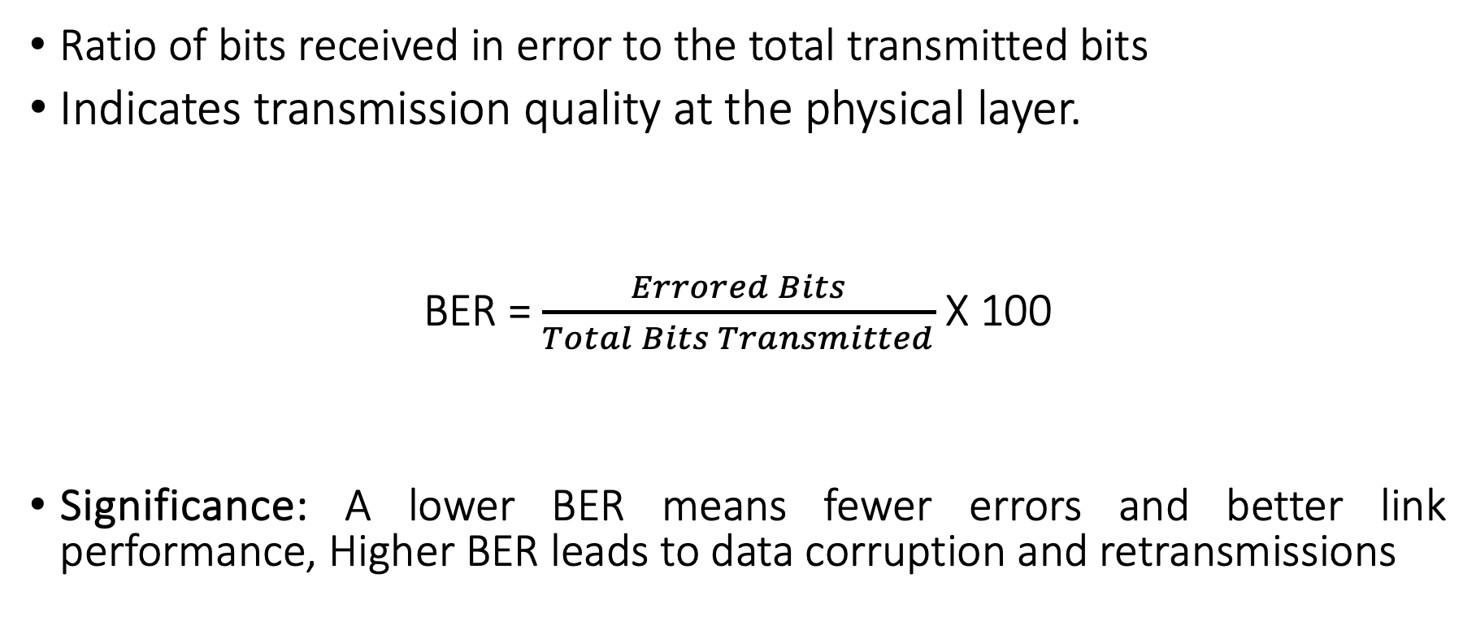
Bit Error Rate (BER)
Ratio of bits received in error to the total transmitted bits
Indicates transmission quality at the physical layer.
BER = $\frac{Errored Bits}{Total Bits Transmitted}$ X 100
Significance: A lower BER means fewer errors and better link performance, Higher BER leads to data corruption and retransmissions

Slide 25
Perspective on Bit Error Rate (BER)
Some perspective on bit error rate values for wired and wireless:
Wired Ethernet: 10⁻¹² (very low errors)
• Wireless Wi-Fi: 10⁻⁶ to 10⁻³ (moderate errors)
• Poor wireless conditions: 10⁻² (high errors)

Slide 26
Examples
Question: A 128-byte packet (1024 bits) is sent with a BER of 10⁻³. How many errors are there per-packet?

Slide 27
Examples
Question: A 128-byte packet (1024 bits) is sent with a BER of 10⁻³. How many errors are there per-packet?
Answer: 1024 X 10⁻³ = 1.024 = 1 bit error / packet

Slide 28
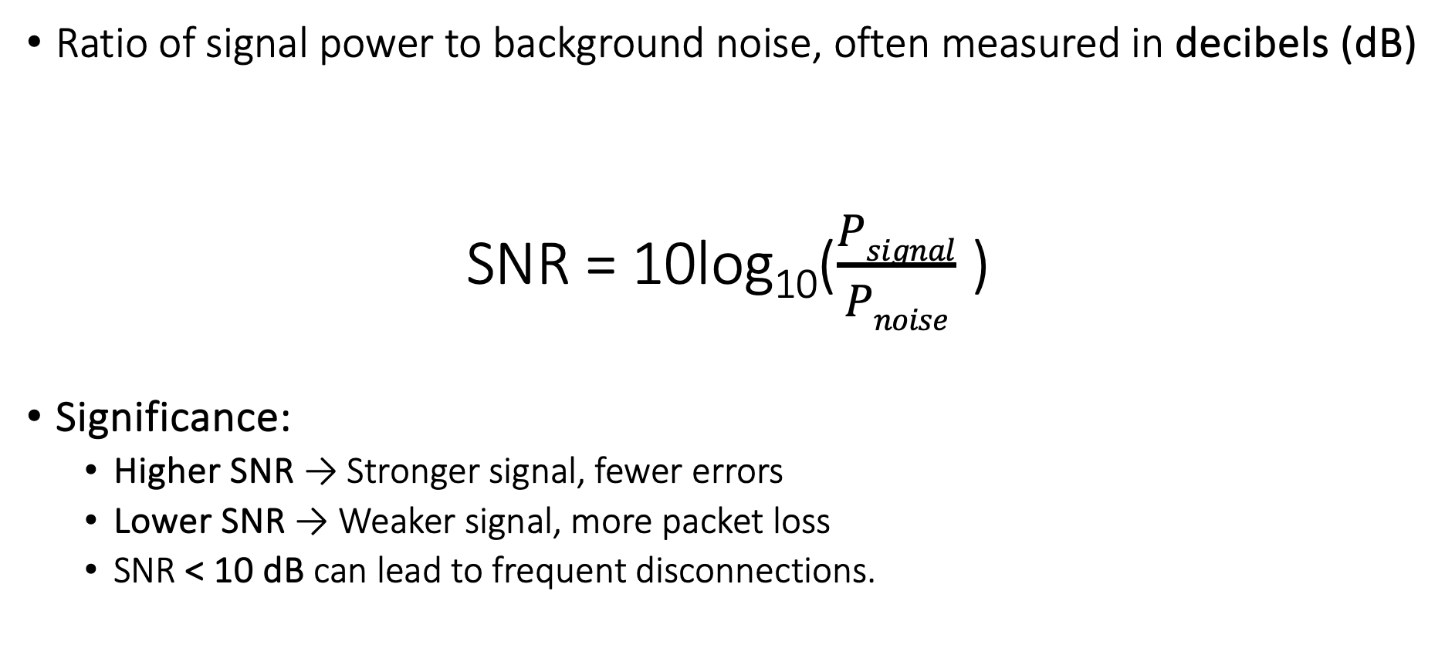
Signal-to-Noise Ratio (SNR)
Ratio of signal power to background noise, often measured in decibels (dB)
SNR = 10log₁₀($\frac{Psignal}{Pnoise}$ )
Significance:
Higher SNR → Stronger signal, fewer errors
Lower SNR → Weaker signal, more packet loss
SNR < 10 dB can lead to frequent disconnections.

Slide 29
Perspective on Signal to Noise Ratio
Some perspective on SNR values:
>25 dB: Excellent (High-speed Wi-Fi, 4G LTE)
• 15-25 dB: Good (Usable but may have errors)
• <10 dB: Poor (Likely unreliable)

Slide 30
Examples
Question: A Wi-Fi user has a signal power of -50 dBm and noise power of -80 dBm. What is the SNR?
Answer:
SNR = (-50) - (-80) = 30 dB

Slide 31
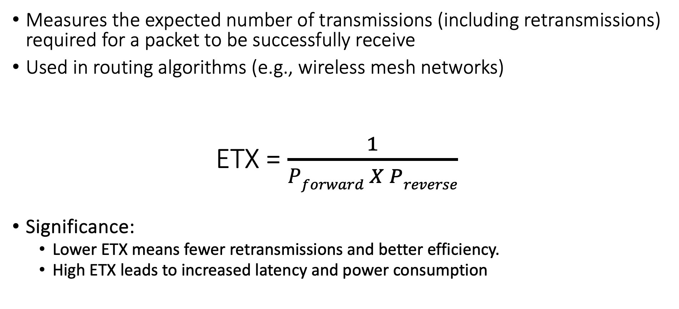
Expected Transmission Count (ETX)
Measures the expected number of transmissions (including retransmissions) required for a packet to be successfully receive
Used in routing algorithms (e.g., wireless mesh networks)
ETX = $\frac{1}{Pforward X Preverse}$
Significance:
Lower ETX means fewer retransmissions and better efficiency.
High ETX leads to increased latency and power consumption

Slide 32
Understanding Channel Capacity & Link Quality
Definition: Maximum rate at which information can be transmitted over a communication channel without error
Channel capacity is measured in the unit of bits/second
How does channel capacity relate to the link quality?

Slide 33
Understanding Channel Capacity & Link Quality
Definition: Maximum rate at which information can be transmitted over a communication channel without error
Channel capacity is measured in the unit of bits/second
How does channel capacity relate to the link quality?
Higher SNR usually leads to a higher capacity
Recall bandwidth is the frequency range over which the signal is transmitted; a wider bandwidth can support higher data rates
Factors that reduce link quality?

Slide 34
Understanding Channel Capacity & Link Quality
Definition: Maximum rate at which information can be transmitted over a communication channel without error
Channel capacity is measured in the unit of bits/second
How does channel capacity relate to the link quality?
Higher SNR usually leads to a higher capacity
Recall bandwidth is the frequency range over which the signal is transmitted; a wider bandwidth can support higher data rates
Factors that reduce link quality? Fading, interference, reduce channel capacity

Slide 35
Understanding Channel Capacity & Link Quality
Definition: Maximum rate at which information can be transmitted over a communication channel without error
Channel capacity is measured in the unit of bits/second
How does channel capacity relate to the link quality?
Higher SNR usually leads to a higher capacity
Recall bandwidth is the frequency range over which the signal is transmitted; a wider bandwidth can support higher data rates
Factors that reduce link quality? Fading, interference, reduce channel capacity
Takeaways:
Good link quality (high SNR, low interference) improves channel capacity
Poor link quality leads to lower achievable data rates, even if the theoretical channel capacity is high

Slide 36
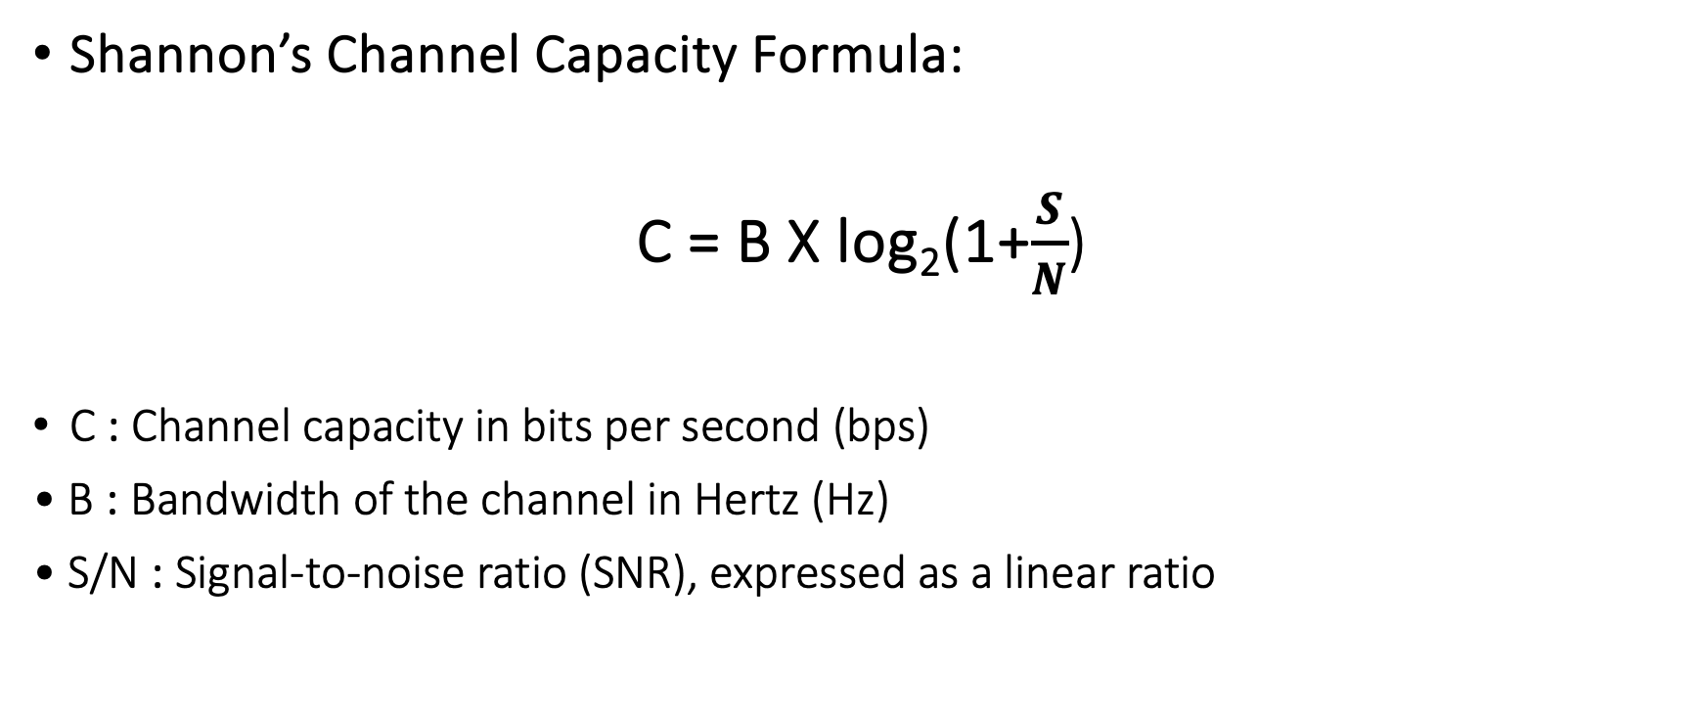
Channel Capacity & Link Quality – The Shannon Perspective
Shannon’s Channel Capacity Formula:
C = B X log₂(1+$\frac{S}{N}$)
C : Channel capacity in bits per second (bps)
• B : Bandwidth of the channel in Hertz (Hz)
• S/N : Signal-to-noise ratio (SNR), expressed as a linear ratio

Slide 37
Example
Available Bandwidth (B): 20 MHz
Signal-to-Noise Ratio (S/N): 30 dB
What is the channel capacity?

Slide 38
Example
Total Available Bandwidth: 20 MHz
Channel Structure: Divided into 4 equal subchannels (5 MHz wide)
SNR Values (in dB) for Each Subchannel:
Subchannel 1: 20 dB
Subchannel 2: 25 dB
Subchannel 3: 30 dB
Subchannel 4: 35 dB
What is the overall channel capacity?

Slide 39
Takeaway from the example and discussion
Different parts of the channel experience varying SNR levels. Calculating capacity per subchannel allows us to capture these variations.
The overall channel capacity is the sum of the capacities of the individual subchannels
In practice, factors such as channel fading, interference, and implementation losses might reduce the achievable capacity below this theoretical maximum
Wireless networks strive to maximize SNR and minimize interference to approach the theoretical capacity
Link quality assessments help determine if network conditions are suitable for high-data-rate applications

Slide 40
Roadmap of the lecture today
Quick Recap
Antenna Continued
Line of Sight and Non Line of Sight
Modulation Basics

Slide 41
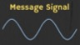
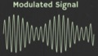
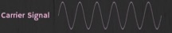
How are radio waves modified to carry information
Encoding information “baseband" in an analog “carrier” signal
Baseband signal often much lower in frequency than the carrier
Frequency of the carrier signal dictates the part of the radio spectrum
Why? baseband signals or information change is at much lower rate
Speech: upto 20 KHz, temperature changes – few Hz
Enables a better usage of the radio spectrum
Enables communication among several devices sharing the spectrum
Modulation
Notes:
First, we look at the computational elements, and these consist of a microcontroller or an FPGA. Today, we find that these computational elements consume at least one order of magnitude higher power consumption when compared to the commonly used sensors.
However, we also find that microcontrollers are increasingly becoming energy efficient. We investigate a typical microcontroller that has been used in sensor platforms over the past two decades. We find that energy efficiency has improved by almost two orders of magnitude. Some of the present-generation microcontrollers, such as Ambiq Apollo4 consume just 3 uA/MHz than 330 uA for MSP430 used on platforms such as TelOS B.
If the trend continues, we can expect the microcontrollers to catch up with the sensors and become energy-efficient. This significant improvement is that the digital components are increasing becoming efficient as they follow moore’s law.

Slide 42
What are different modulation techniques?
Vary frequency, amplitude, phase of carrier signal according message signal
We can also vary them together to support complex modulation schemes
Analog and Digital counterparts of these modulation schemes exist
Modulation
Notes:
First, we look at the computational elements, and these consist of a microcontroller or an FPGA. Today, we find that these computational elements consume at least one order of magnitude higher power consumption when compared to the commonly used sensors.
However, we also find that microcontrollers are increasingly becoming energy efficient. We investigate a typical microcontroller that has been used in sensor platforms over the past two decades. We find that energy efficiency has improved by almost two orders of magnitude. Some of the present-generation microcontrollers, such as Ambiq Apollo4 consume just 3 uA/MHz than 330 uA for MSP430 used on platforms such as TelOS B.
If the trend continues, we can expect the microcontrollers to catch up with the sensors and become energy-efficient. This significant improvement is that the digital components are increasing becoming efficient as they follow moore’s law.

Slide 43
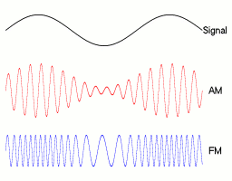
Amplitude modulation: vary amplitude of carrier signal
Change amplitude of a carrier signal according to the message signal
Simplest and the earliest modulation technique
Remains widely used for radio broadcast, also computer communication
Notes:
First, we look at the computational elements, and these consist of a microcontroller or an FPGA. Today, we find that these computational elements consume at least one order of magnitude higher power consumption when compared to the commonly used sensors.
However, we also find that microcontrollers are increasingly becoming energy efficient. We investigate a typical microcontroller that has been used in sensor platforms over the past two decades. We find that energy efficiency has improved by almost two orders of magnitude. Some of the present-generation microcontrollers, such as Ambiq Apollo4 consume just 3 uA/MHz than 330 uA for MSP430 used on platforms such as TelOS B.
If the trend continues, we can expect the microcontrollers to catch up with the sensors and become energy-efficient. This significant improvement is that the digital components are increasing becoming efficient as they follow moore’s law.

Slide 44
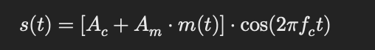
Amplitude modulation: vary amplitude of carrier signal
A_{c} = Carrier amplitude
A_{m} = Modulating (baseband) signal amplitude
m(t) = Message signal
f_{c} = Carrier frequency

Slide 45
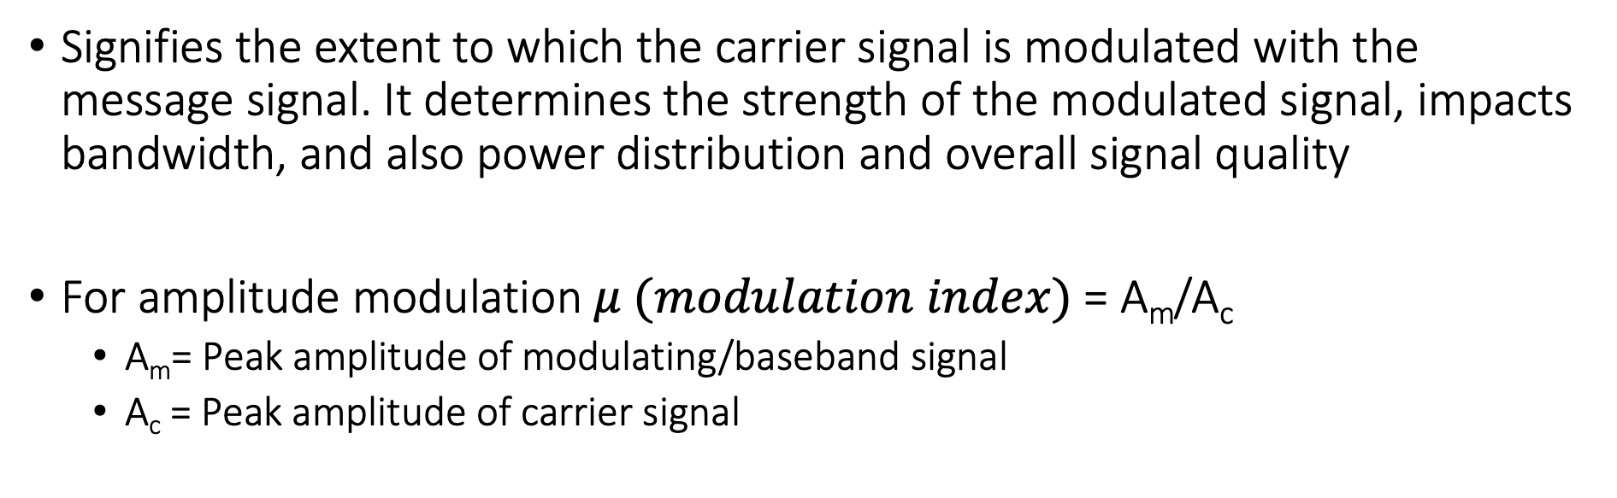
Modulation Index
Signifies the extent to which the carrier signal is modulated with the message signal. It determines the strength of the modulated signal, impacts bandwidth, and also power distribution and overall signal quality
For amplitude modulation $μ (modulation index)$= A_{m}/A_{c}
A_{m}= Peak amplitude of modulating/baseband signal
A_{c} = Peak amplitude of carrier signal

Slide 46
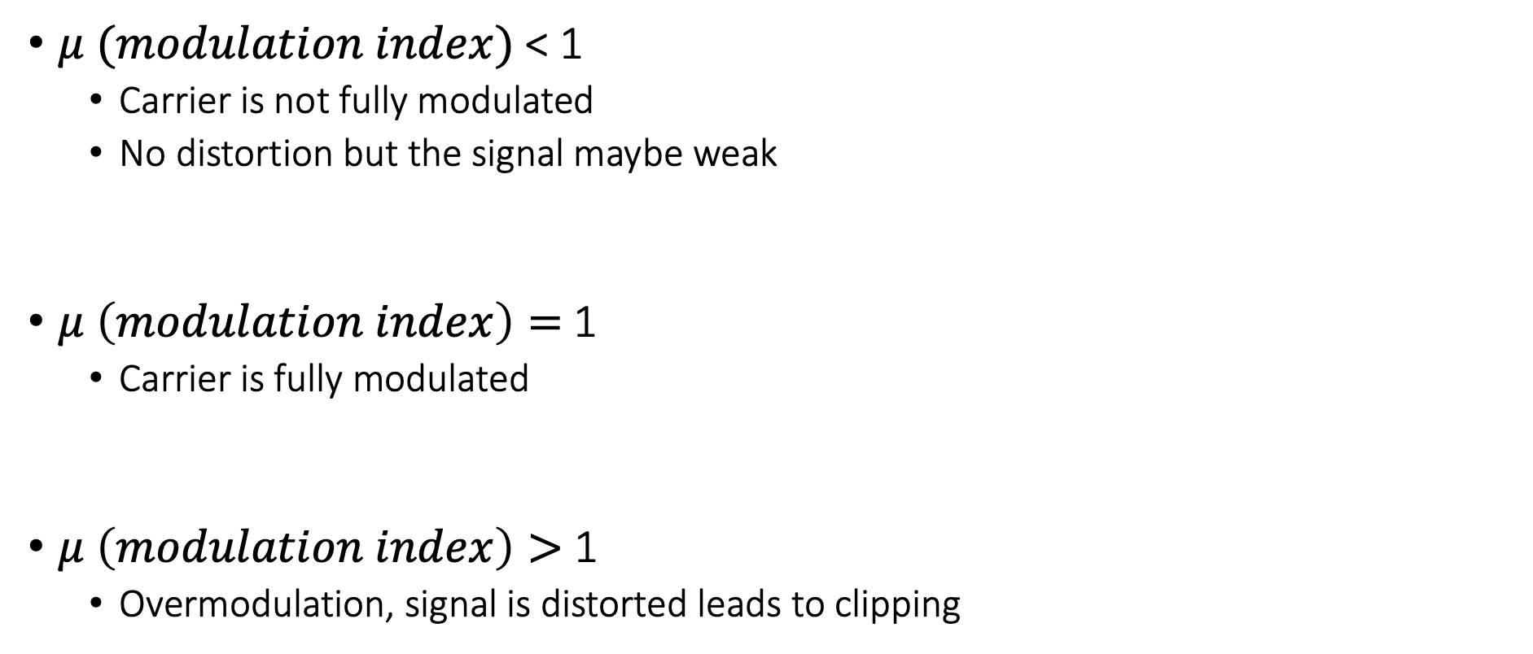

Significance of modulation index ($μ$)
$μ (modulation index)$< 1
Carrier is not fully modulated
No distortion but the signal maybe weak
$μ \left(modulation index\right)=$1
Carrier is fully modulated
$μ \left(modulation index\right)>$ 1
Overmodulation, signal is distorted leads to clipping

Slide 47
Amplitude modulation example
You are given a carrier signal with the frequency of 100 KHz and amplitude of 5. It is modulated using amplitude modulation (double side band, full carrier) with a message/baseband signal of the frequency 5 KHz and amplitude 2.
Please determine modulation index and mathematical expression representing the modulated signal?

Slide 48
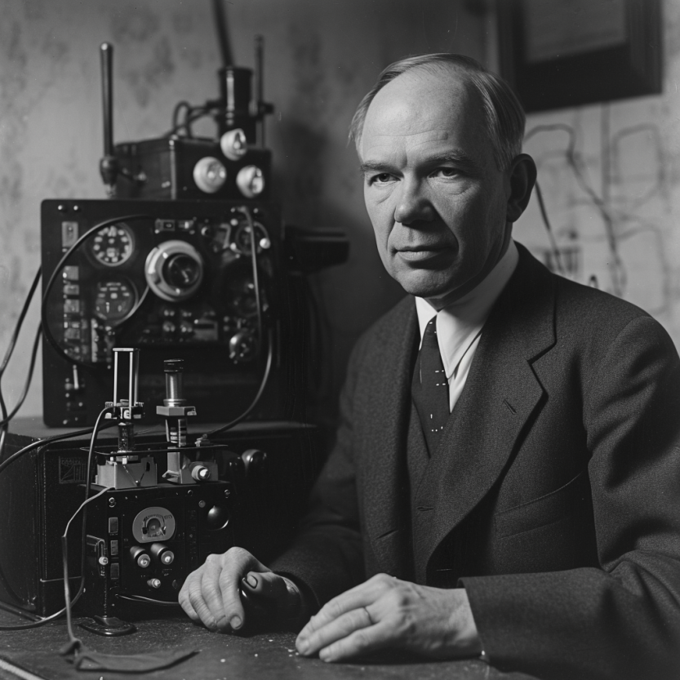
Frequency modulation: vary frequency of carrier signal
Change frequency of a carrier signal according to the message signal
Advantages (over AM): Resilient to interference, spectrum efficiency
Remains widely used for radio broadcast, also computer communication
First demonstrated by Armstrong in 1935!
Notes:
First, we look at the computational elements, and these consist of a microcontroller or an FPGA. Today, we find that these computational elements consume at least one order of magnitude higher power consumption when compared to the commonly used sensors.
However, we also find that microcontrollers are increasingly becoming energy efficient. We investigate a typical microcontroller that has been used in sensor platforms over the past two decades. We find that energy efficiency has improved by almost two orders of magnitude. Some of the present-generation microcontrollers, such as Ambiq Apollo4 consume just 3 uA/MHz than 330 uA for MSP430 used on platforms such as TelOS B.
If the trend continues, we can expect the microcontrollers to catch up with the sensors and become energy-efficient. This significant improvement is that the digital components are increasing becoming efficient as they follow moore’s law.

Slide 49
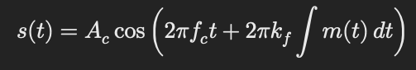
Frequency modulation: vary frequency of carrier signal
A_{c} = Carrier amplitude
f_{c} = Carrier frequency
k_{f} = Frequency sensitivity of the modulator (how much the carrier frequency changes in response to the amplitude of the modulating signal)
m(t) = Modulating signal
Notes:
First, we look at the computational elements, and these consist of a microcontroller or an FPGA. Today, we find that these computational elements consume at least one order of magnitude higher power consumption when compared to the commonly used sensors.
However, we also find that microcontrollers are increasingly becoming energy efficient. We investigate a typical microcontroller that has been used in sensor platforms over the past two decades. We find that energy efficiency has improved by almost two orders of magnitude. Some of the present-generation microcontrollers, such as Ambiq Apollo4 consume just 3 uA/MHz than 330 uA for MSP430 used on platforms such as TelOS B.
If the trend continues, we can expect the microcontrollers to catch up with the sensors and become energy-efficient. This significant improvement is that the digital components are increasing becoming efficient as they follow moore’s law.

Slide 50
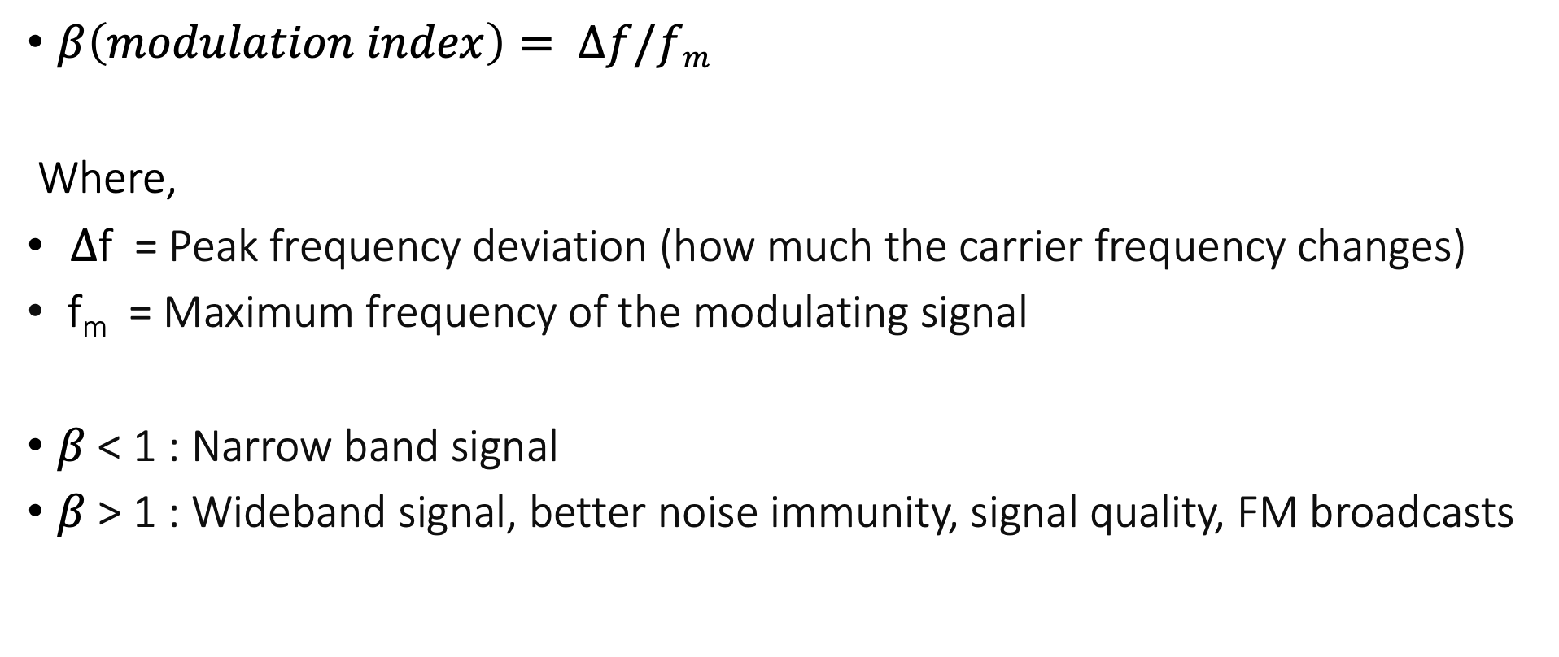
Modulation Index of frequency modulated signal
$β\left(modulation index\right)= ∆f/fm$
Where,
$∆$f = Peak frequency deviation (how much the carrier frequency changes)
f_{m} = Maximum frequency of the modulating signal
$β$ < 1 : Narrow band signal
$β$ > 1 : Wideband signal, better noise immunity, signal quality, FM broadcasts
Notes:
First, we look at the computational elements, and these consist of a microcontroller or an FPGA. Today, we find that these computational elements consume at least one order of magnitude higher power consumption when compared to the commonly used sensors.
However, we also find that microcontrollers are increasingly becoming energy efficient. We investigate a typical microcontroller that has been used in sensor platforms over the past two decades. We find that energy efficiency has improved by almost two orders of magnitude. Some of the present-generation microcontrollers, such as Ambiq Apollo4 consume just 3 uA/MHz than 330 uA for MSP430 used on platforms such as TelOS B.
If the trend continues, we can expect the microcontrollers to catch up with the sensors and become energy-efficient. This significant improvement is that the digital components are increasing becoming efficient as they follow moore’s law.

Slide 51
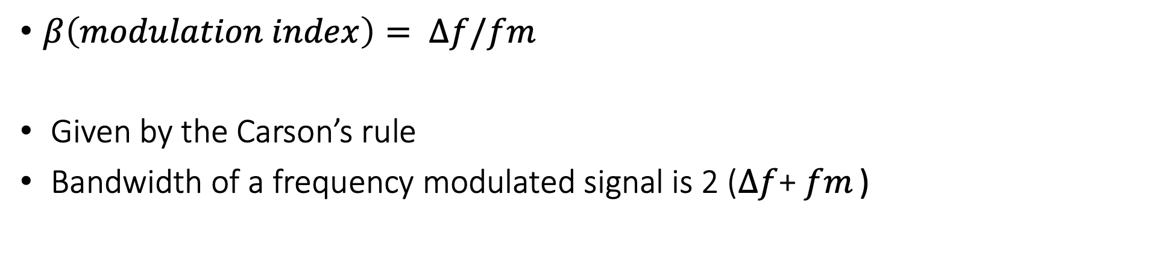
Bandwidth of frequency modulated signals
$β\left(modulation index\right)= ∆f/fm$
Given by the Carson’s rule
Bandwidth of a frequency modulated signal is 2 ($∆f$+ $fm$ )
Notes:
First, we look at the computational elements, and these consist of a microcontroller or an FPGA. Today, we find that these computational elements consume at least one order of magnitude higher power consumption when compared to the commonly used sensors.
However, we also find that microcontrollers are increasingly becoming energy efficient. We investigate a typical microcontroller that has been used in sensor platforms over the past two decades. We find that energy efficiency has improved by almost two orders of magnitude. Some of the present-generation microcontrollers, such as Ambiq Apollo4 consume just 3 uA/MHz than 330 uA for MSP430 used on platforms such as TelOS B.
If the trend continues, we can expect the microcontrollers to catch up with the sensors and become energy-efficient. This significant improvement is that the digital components are increasing becoming efficient as they follow moore’s law.

Slide 52
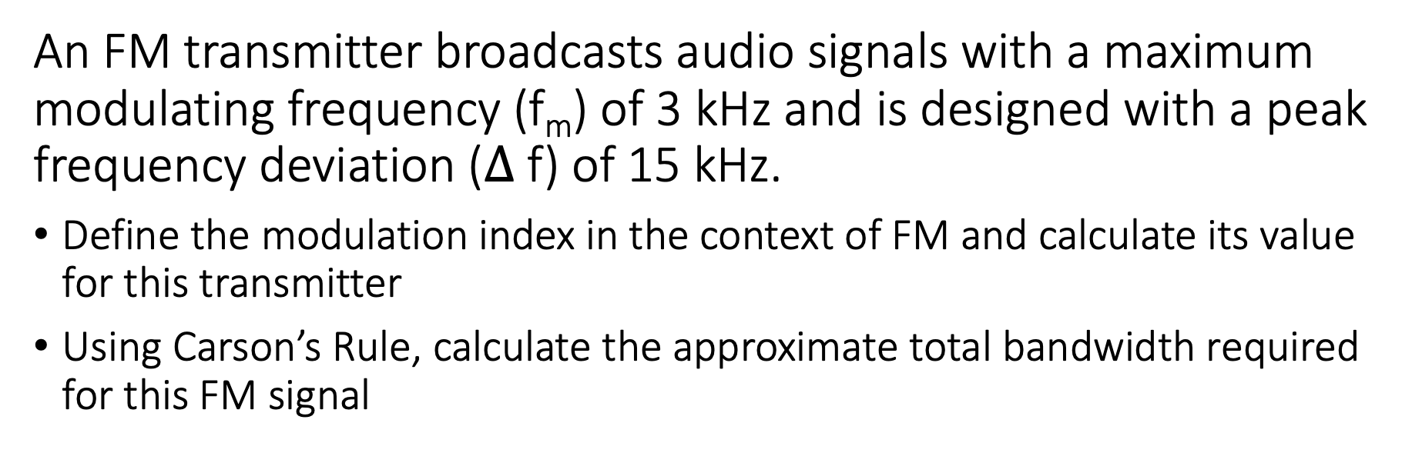
Frequency modulation example
An FM transmitter broadcasts audio signals with a maximum modulating frequency (f_{m}) of 3 kHz and is designed with a peak frequency deviation ($∆$ f) of 15 kHz.
Define the modulation index in the context of FM and calculate its value for this transmitter
Using Carson’s Rule, calculate the approximate total bandwidth required for this FM signal

Slide 53
Frequency deviation, Carson’s Rule, Takeaway
Frequency deviation (f) is the maximum departure of the instantaneous frequency of the FM signal from the carrier frequency due to modulation
Determines the extent of frequency variation, which in turn affects the transmitted signal’s spectrum
Carson’s rule provides a practical estimate of the bandwidth by accounting for the significant sidebands that contain most of the signal’s power. Ensures that the majority of the signal’s power is transmitted within the calculated bandwidth, making it a valuable tool for system planning and regulatory compliance.

Slide 54
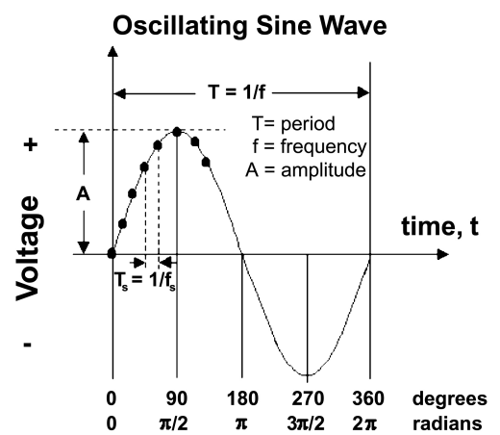
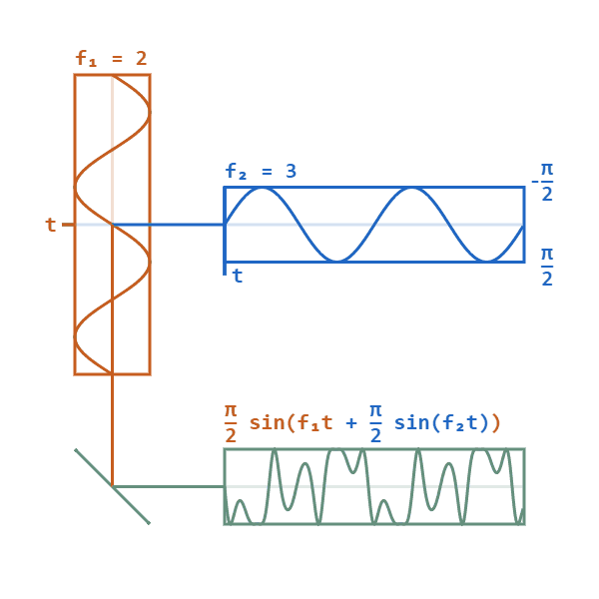
Phase modulation: vary phase of carrier signal
Change phase of a carrier signal according to the message signal
It is an integral part of modern communication standards: WiFi, Television
Advantages (over FM): Better SNR, spectral efficiency
Notes:
First, we look at the computational elements, and these consist of a microcontroller or an FPGA. Today, we find that these computational elements consume at least one order of magnitude higher power consumption when compared to the commonly used sensors.
However, we also find that microcontrollers are increasingly becoming energy efficient. We investigate a typical microcontroller that has been used in sensor platforms over the past two decades. We find that energy efficiency has improved by almost two orders of magnitude. Some of the present-generation microcontrollers, such as Ambiq Apollo4 consume just 3 uA/MHz than 330 uA for MSP430 used on platforms such as TelOS B.
If the trend continues, we can expect the microcontrollers to catch up with the sensors and become energy-efficient. This significant improvement is that the digital components are increasing becoming efficient as they follow moore’s law.

Slide 55
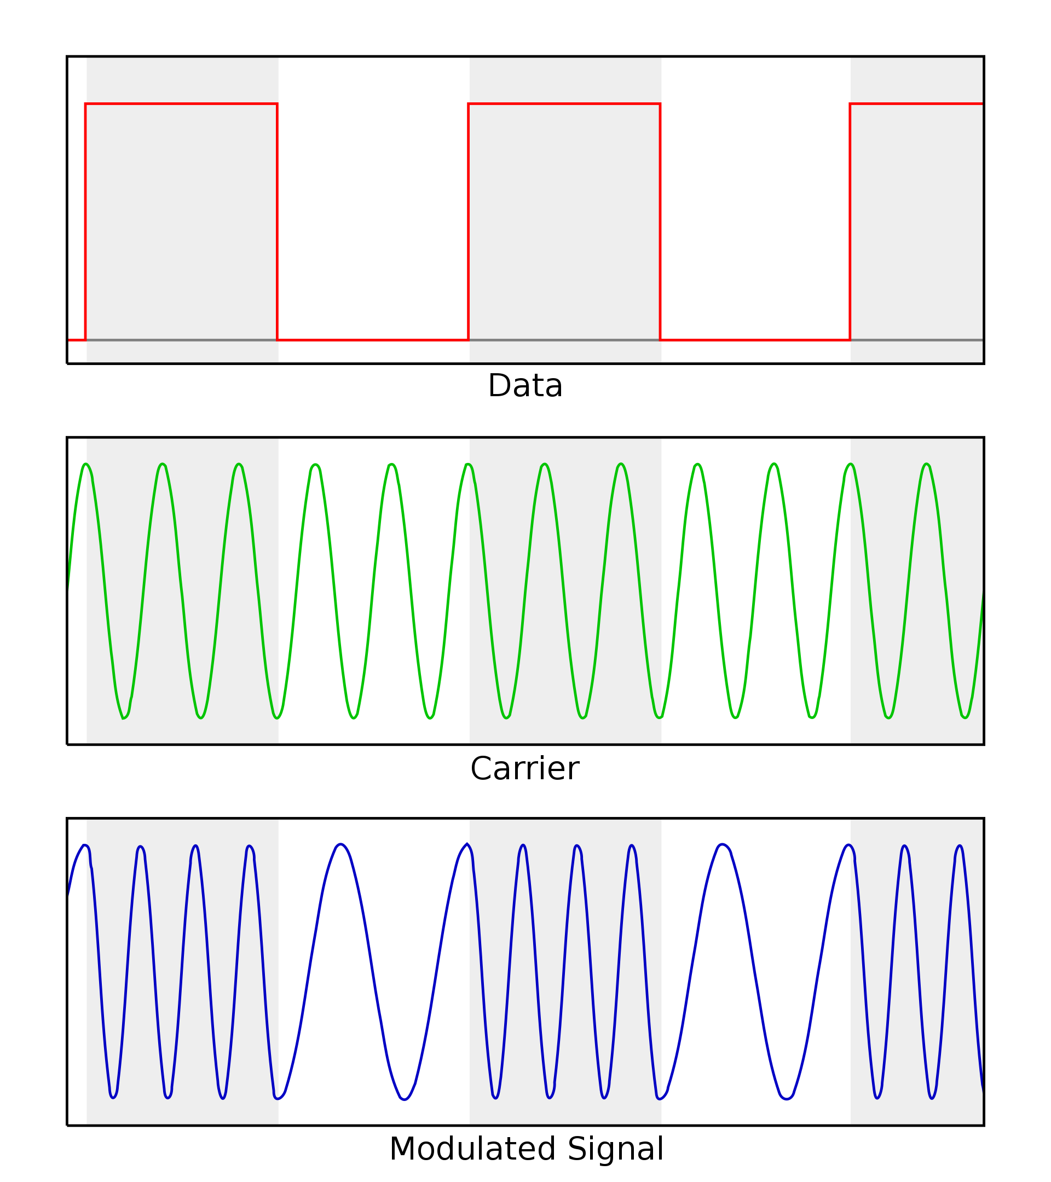
Digital equivalent of the AM, FM and PM modulation
Digital variant of these schemes vary analog signal according to digital bits
ASK: amplitude shift keying
FSK: frequency shift keying
PSK: phase shift keying
Digital variants relevant when we talk about computer communication
Notes:
First, we look at the computational elements, and these consist of a microcontroller or an FPGA. Today, we find that these computational elements consume at least one order of magnitude higher power consumption when compared to the commonly used sensors.
However, we also find that microcontrollers are increasingly becoming energy efficient. We investigate a typical microcontroller that has been used in sensor platforms over the past two decades. We find that energy efficiency has improved by almost two orders of magnitude. Some of the present-generation microcontrollers, such as Ambiq Apollo4 consume just 3 uA/MHz than 330 uA for MSP430 used on platforms such as TelOS B.
If the trend continues, we can expect the microcontrollers to catch up with the sensors and become energy-efficient. This significant improvement is that the digital components are increasing becoming efficient as they follow moore’s law.

Slide 56
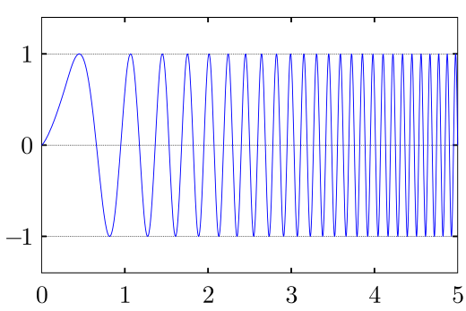
Even more complex modulation schemes exist
Builds on simple modulation schemes AM, FM, PM (or digital equivalent)
Briefly cover some during later part of the course
Complex modulation schemes ensure better performance
Spectral efficiency
Higher range
Higher throughput
……
Choice of the modulation scheme depends on the target application
Notes:
First, we look at the computational elements, and these consist of a microcontroller or an FPGA. Today, we find that these computational elements consume at least one order of magnitude higher power consumption when compared to the commonly used sensors.
However, we also find that microcontrollers are increasingly becoming energy efficient. We investigate a typical microcontroller that has been used in sensor platforms over the past two decades. We find that energy efficiency has improved by almost two orders of magnitude. Some of the present-generation microcontrollers, such as Ambiq Apollo4 consume just 3 uA/MHz than 330 uA for MSP430 used on platforms such as TelOS B.
If the trend continues, we can expect the microcontrollers to catch up with the sensors and become energy-efficient. This significant improvement is that the digital components are increasing becoming efficient as they follow moore’s law.

Slide 57
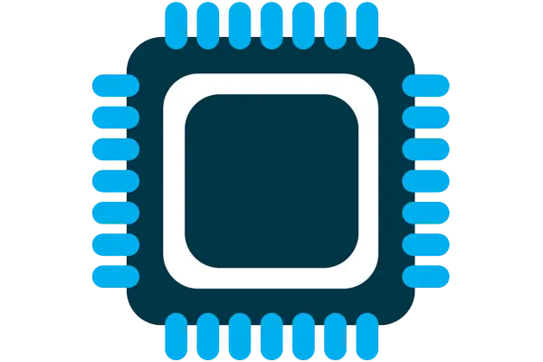



What are components of internet of things
Computation and Storage
Sensing and Actuation
Power
Wireless Connectivity
Notes:
First, we look at the computational elements, and these consist of a microcontroller or an FPGA. Today, we find that these computational elements consume at least one order of magnitude higher power consumption when compared to the commonly used sensors.
However, we also find that microcontrollers are increasingly becoming energy efficient. We investigate a typical microcontroller that has been used in sensor platforms over the past two decades. We find that energy efficiency has improved by almost two orders of magnitude. Some of the present-generation microcontrollers, such as Ambiq Apollo4 consume just 3 uA/MHz than 330 uA for MSP430 used on platforms such as TelOS B.
If the trend continues, we can expect the microcontrollers to catch up with the sensors and become energy-efficient. This significant improvement is that the digital components are increasing becoming efficient as they follow moore’s law.

Slide 58
Microcontrollers are heart of embedded systems
A microcontroller (µC) is a small computer on a single integrated circuit consisting of a relatively simple central processing unit (CPU) combined with peripheral devices such as memories, I/O devices, and timers
More than half of all CPUs sold are microcontroller (and growing)
Low-power, often includes sleep mode that dramatically reduces the power consumed to micro or even nanowatts
Notes:
Backscatter communication actually help us overcome this limitation

Slide 59
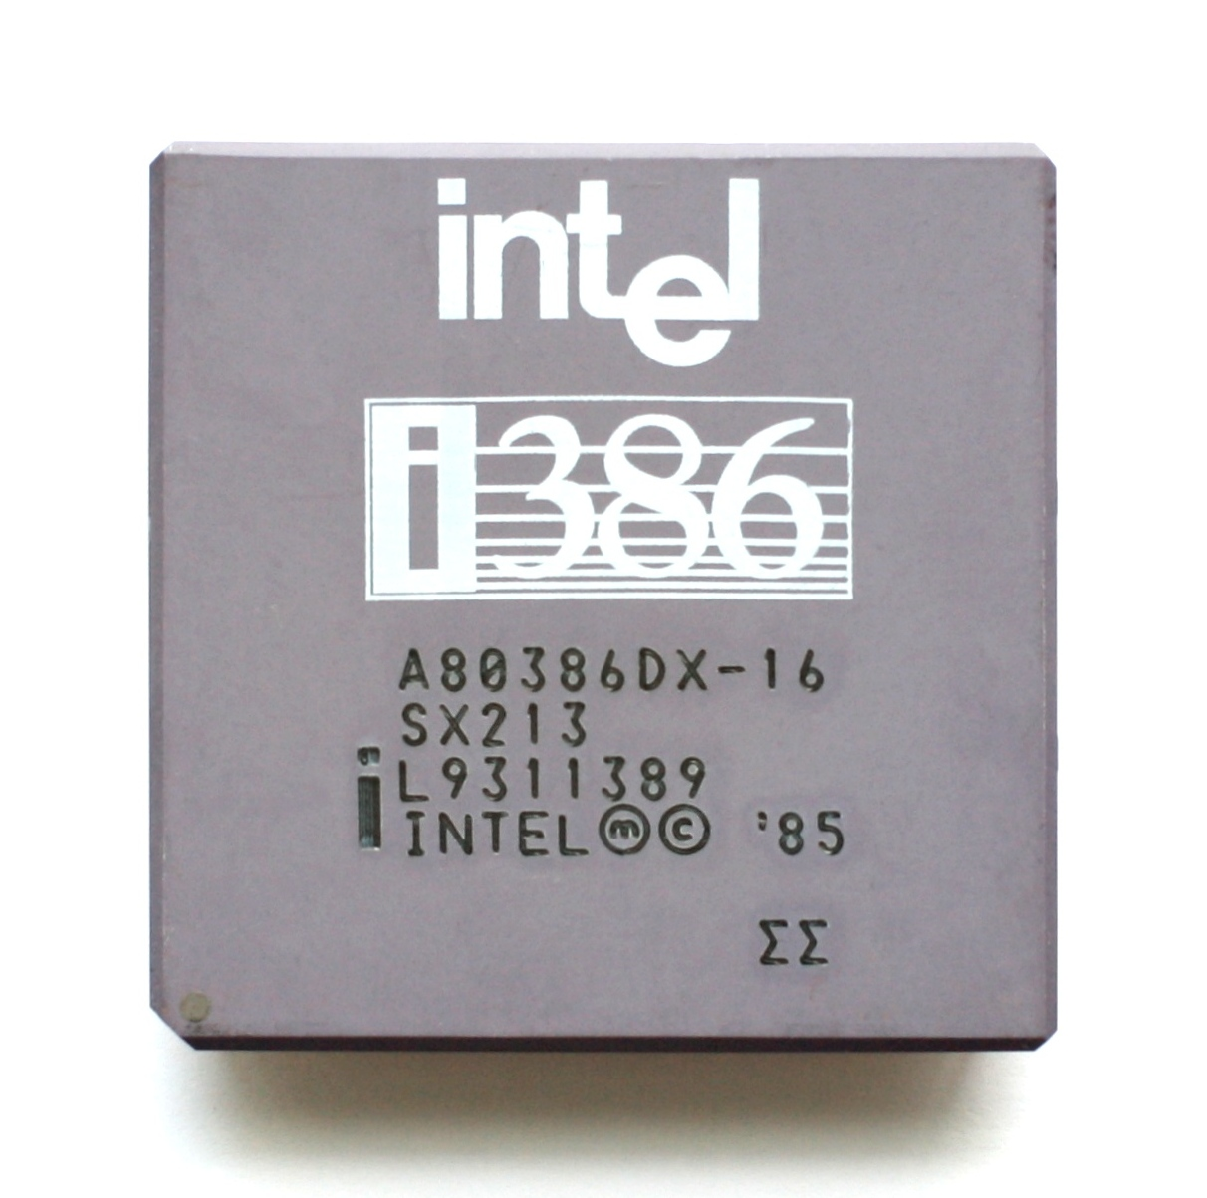
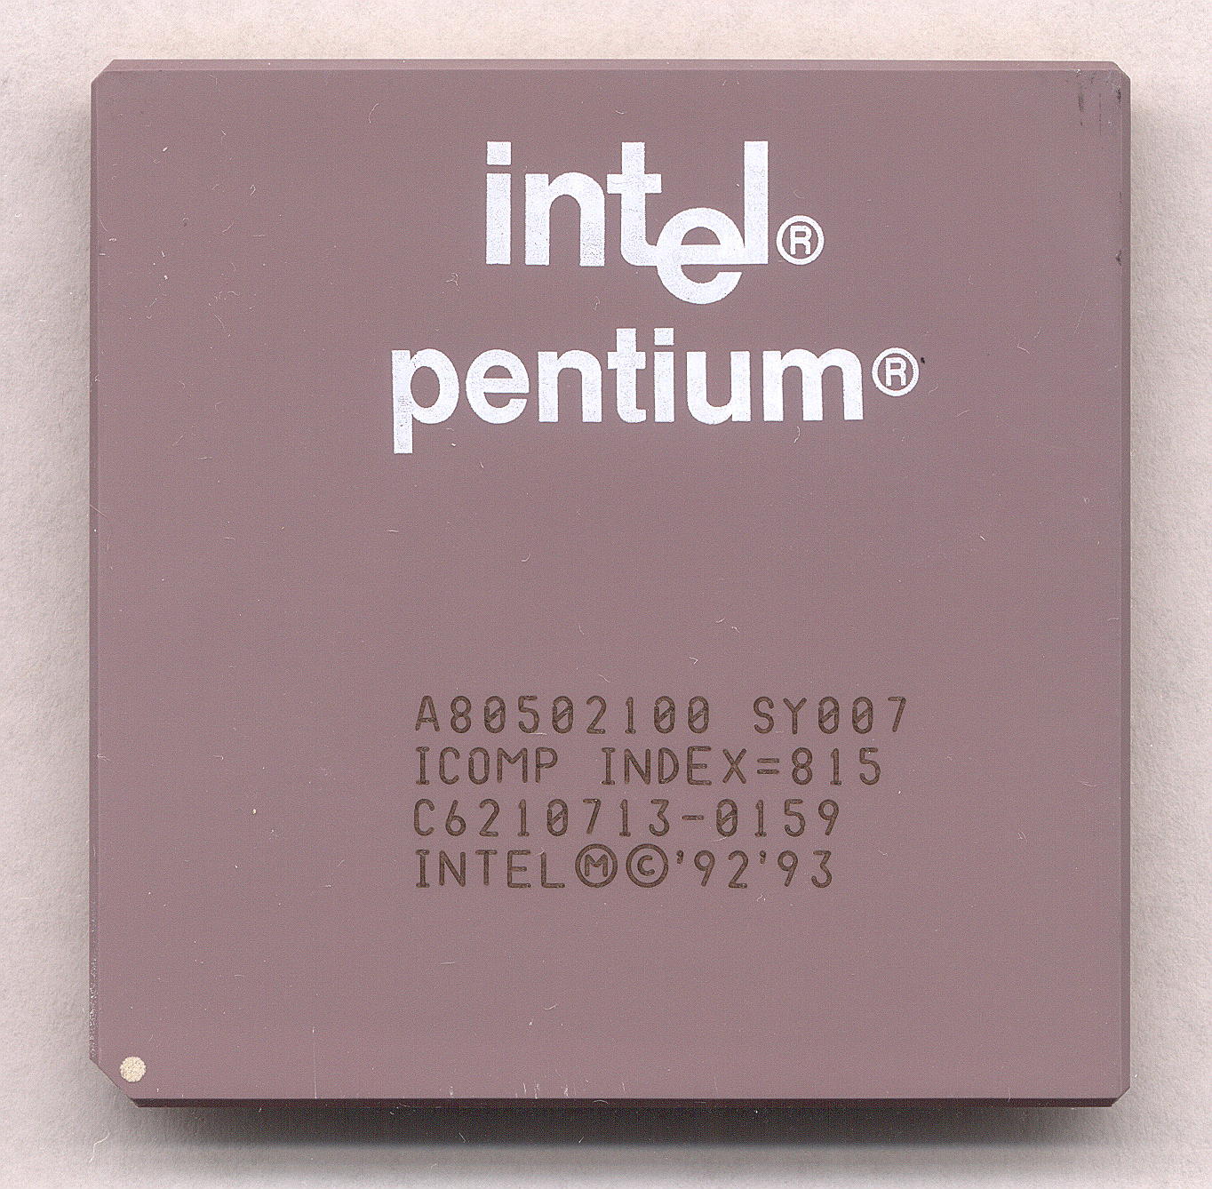
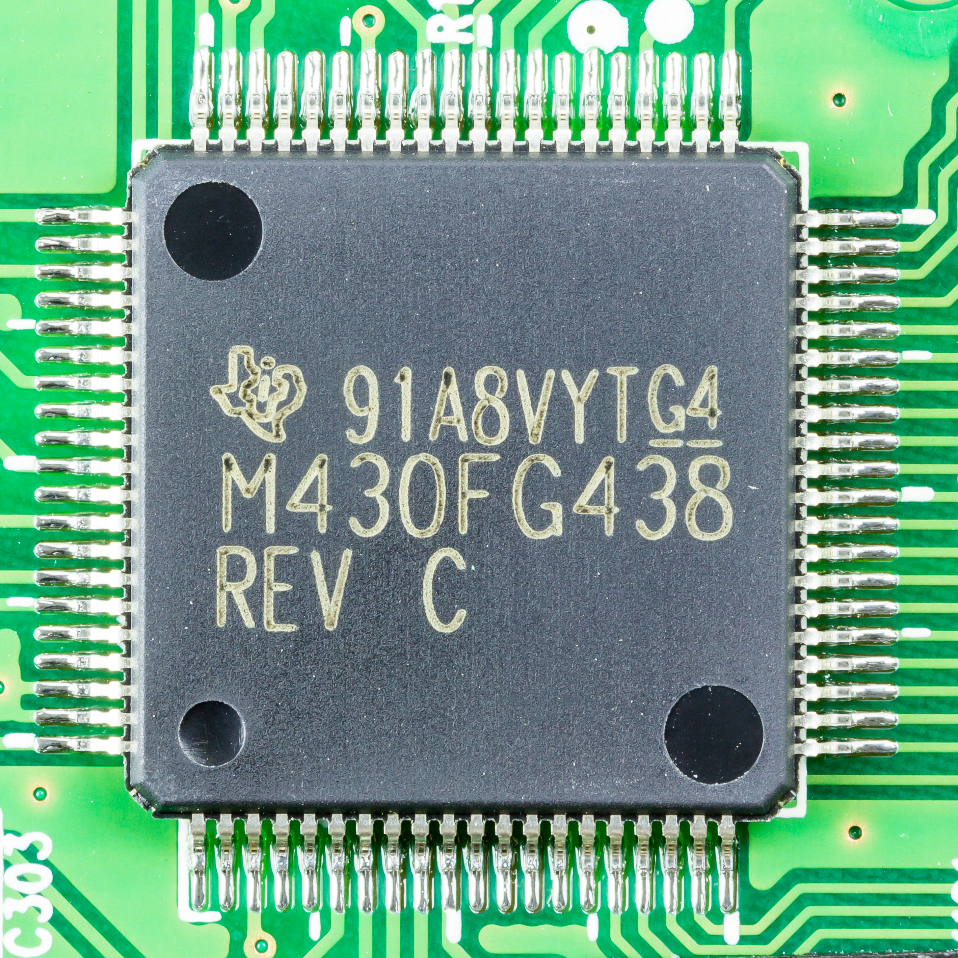
What is heart of computers and internet of things
Microprocessor (Computers)
They usually don’t have peripherals or memory
CPU + Pins (No memory, peripherals)
Your computer typically has a microprocessor
Microcontrollers (Internet of Things)
Memory + Peripherals + CPU + Pins
Peripherals: Specialized hardware units within the chip
Notes:
Backscatter communication actually help us overcome this limitation

Slide 60
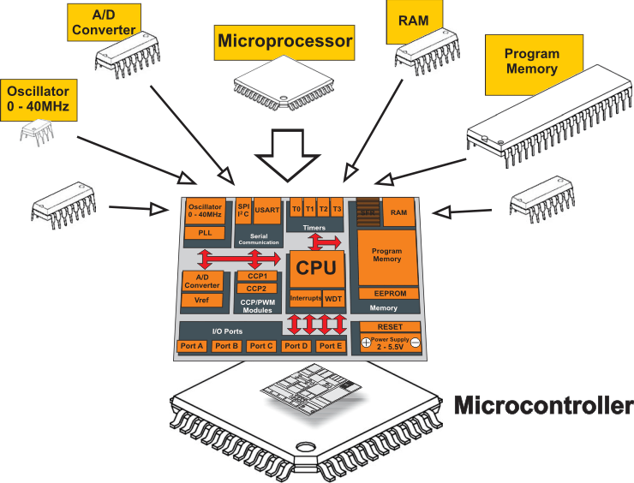
What is a microcontroller? Microprocessor + Peripherals + Memory + Pins + ?
Microcontroller
Processor
Peripherals
Pins
Memory
Notes:
Backscatter communication actually help us overcome this limitation

Slide 61
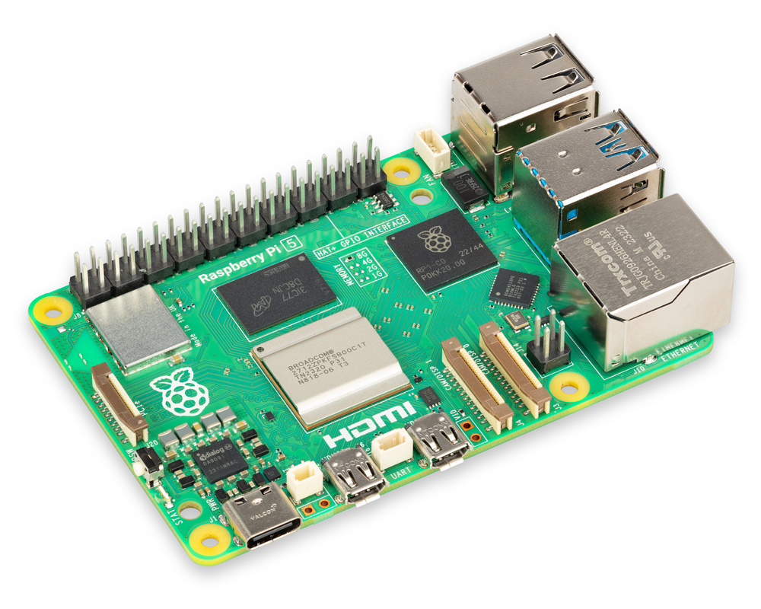

System on chips
System on chips (SoC)
Microcontroller + Extensive Peripherals
Essentially multiple chips combined
Example: Radios, ML accelerators in a single chip
Notes:
Backscatter communication actually help us overcome this limitation

Slide 62
An image of the die of a microcontroller

Slide 63
Instruction set architecture and realization
Instruction set architecture (ISA): It is the definition of the instructions that the processor can execute and certain structural constraints (such as word size) that realizations must share.
Processor, Realization, Chip: Piece of silicon sold by a vendor which is the realization of the ISA.
A ISA may appear in many different chips, often made by different manufacturers, and often having widely varying performance profiles.
Advantages?

Slide 64
Instruction set architecture and realization
Instruction set architecture (ISA): It is the definition of the instructions that the processor can execute and certain structural constraints (such as word size) that realizations must share.
Processor, Realization, Chip: Piece of silicon sold by a vendor which is the realization of the ISA.
A ISA may appear in many different chips, often made by different manufacturers, and often having widely varying performance profiles.
Advantages? Sharing an ISA in a family of processors is that software tools, which are costly to develop, may be shared, and (sometimes) the same programs may run correctly on multiple realizations.

Slide 65
Instruction set architecture and realization
Instruction set architecture (ISA): It is the definition of the instructions that the processor can execute and certain structural constraints (such as word size) that realizations must share.
Processor, Realization, Chip: Piece of silicon sold by a vendor which is the realization of the ISA.
Does ARM make it’s own chip? What is Cortex-M series?
What are some ISAs? And chip you can recall?

Slide 66
Other embedded microcontroller architectures
Motorola 6800
Intel 8080
Intel 8051
Atmel AVR
ARM
Motorola Coldfire
MIPS
PowerPC
............

Slide 67
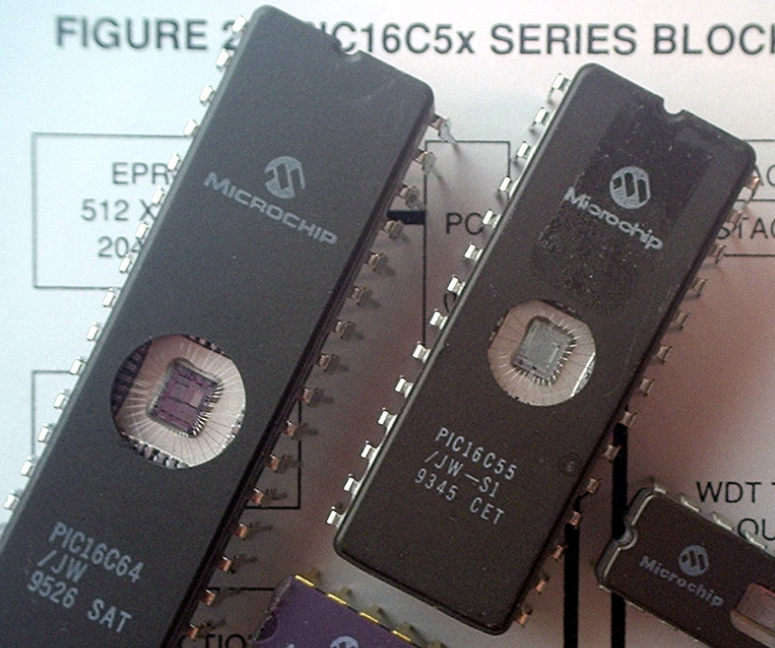
Some example of older microcontrollers
Cheap , small computer systems
PIC
8, 16, and 24-bit MIPs architecture
PICAXE available with Basic interpreter
AVR
8-bit custom architecture (AVR architecture)
Used in Arduinos
AT Tiny 4: $0.30 per unit
4 I/O pins, 32 Bytes RAM, 512 Bytes ROM

Slide 68
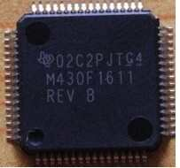
More capable microcontrollers (00s-10s)
Diversify into extreme low power and more capable systems
MSP430
16-bit custom architecture (MSP430 architecture)
Capable, but also extremely low power
<1 μA sleep current
STM32, Atmel SAM series (Cortex-M0, M3, M4, M4F)
32-bit ARM architecture (ARMv7)
Leverage success of ARM on smartphones
Every peripheral under the sun. Plus a variety of memory choices

Slide 69
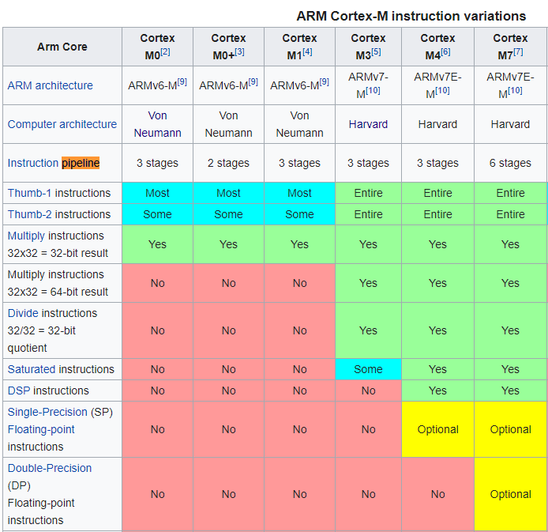
ARM Cortex M Series
A number of options for increasing capabilities
In practice:
Cortex-M0+ for low-end systems
Coretx-M4 for high capability systems

Slide 70
Digital Signal Processor
Many embedded applications require performing of signal processing. Can you think of some embedded applications?
Characteristics of application requiring signal processing:
Deal with large amounts of information
Sample in time, space or both
Sophisticated mathematical operations like filtering, frequency analysis
Digital signal processor are class of processors optimized for such mathematically intensive tasks

Slide 71
Digital Signal Processor
Many embedded applications require performing of signal processing. Can you think of some embedded applications?
Characteristics of application requiring signal processing:
Deal with large amounts of information
Sample in time, space or both
Sophisticated mathematical operations like filtering, frequency analysis
Digital signal processor are class of processors optimized for such mathematically intensive tasks

Slide 72
Multicore and Multiprocessor architecture
A multicore consists of more than one processor on a single chip
Existed since 1990’s, but has seen a great uptake recently
Becoming more and more relevant for embedded systems
Heterogeneous multicore: Combines different processors on a single chip. Even following different ISAs.
Applications which require multicore architecture?

Slide 73
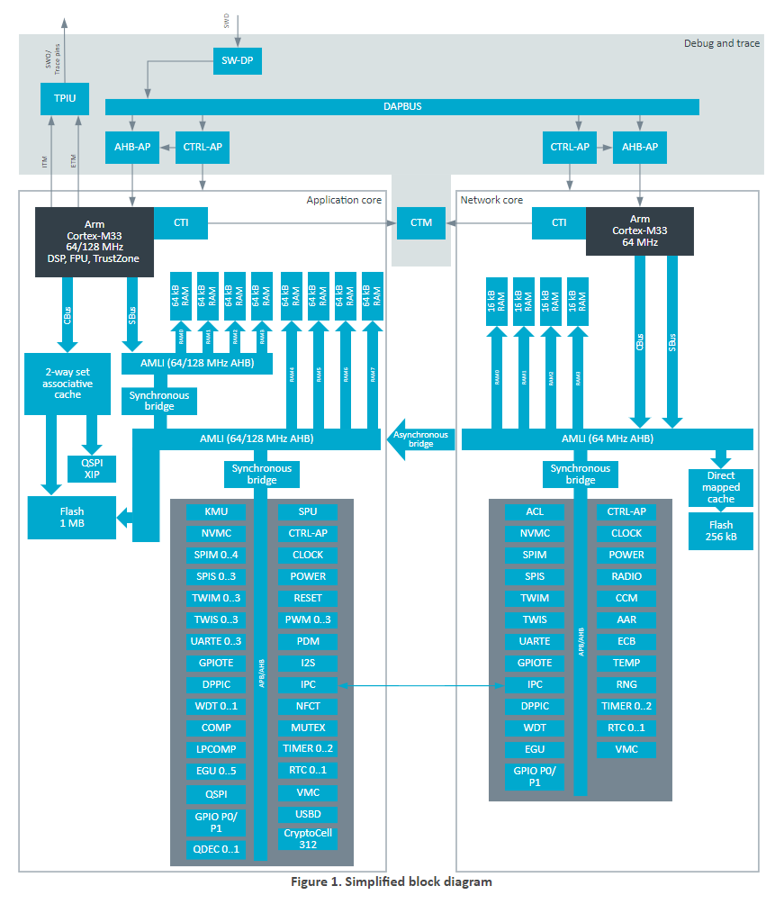
What are trends for future microcontrollers
Multi-core systems
Not for performance, but for separation of concerns
Run radio code on one core
Application code goes on the other core
Also allows BIG.little architecture
Higher performance core when interpreting data
Lower performance core for sampling sensors
nRF53 series is already doing this
But support is still nascent

Slide 74
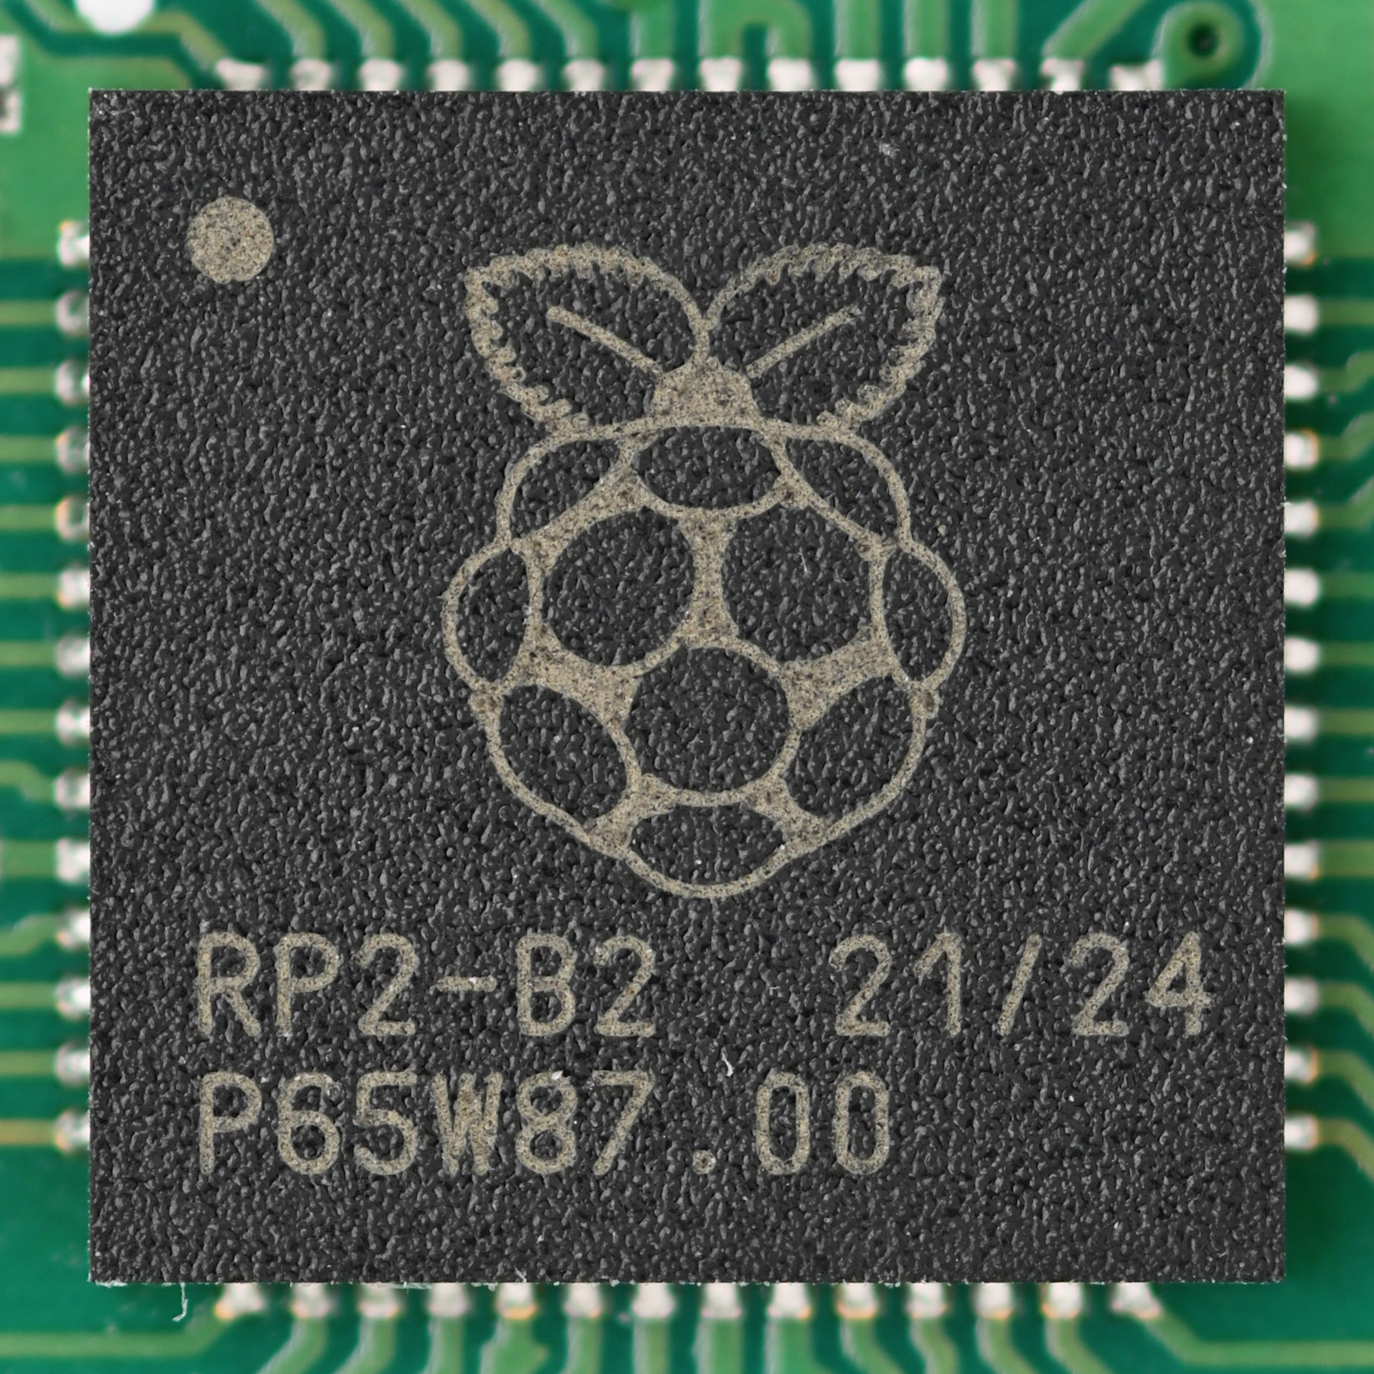
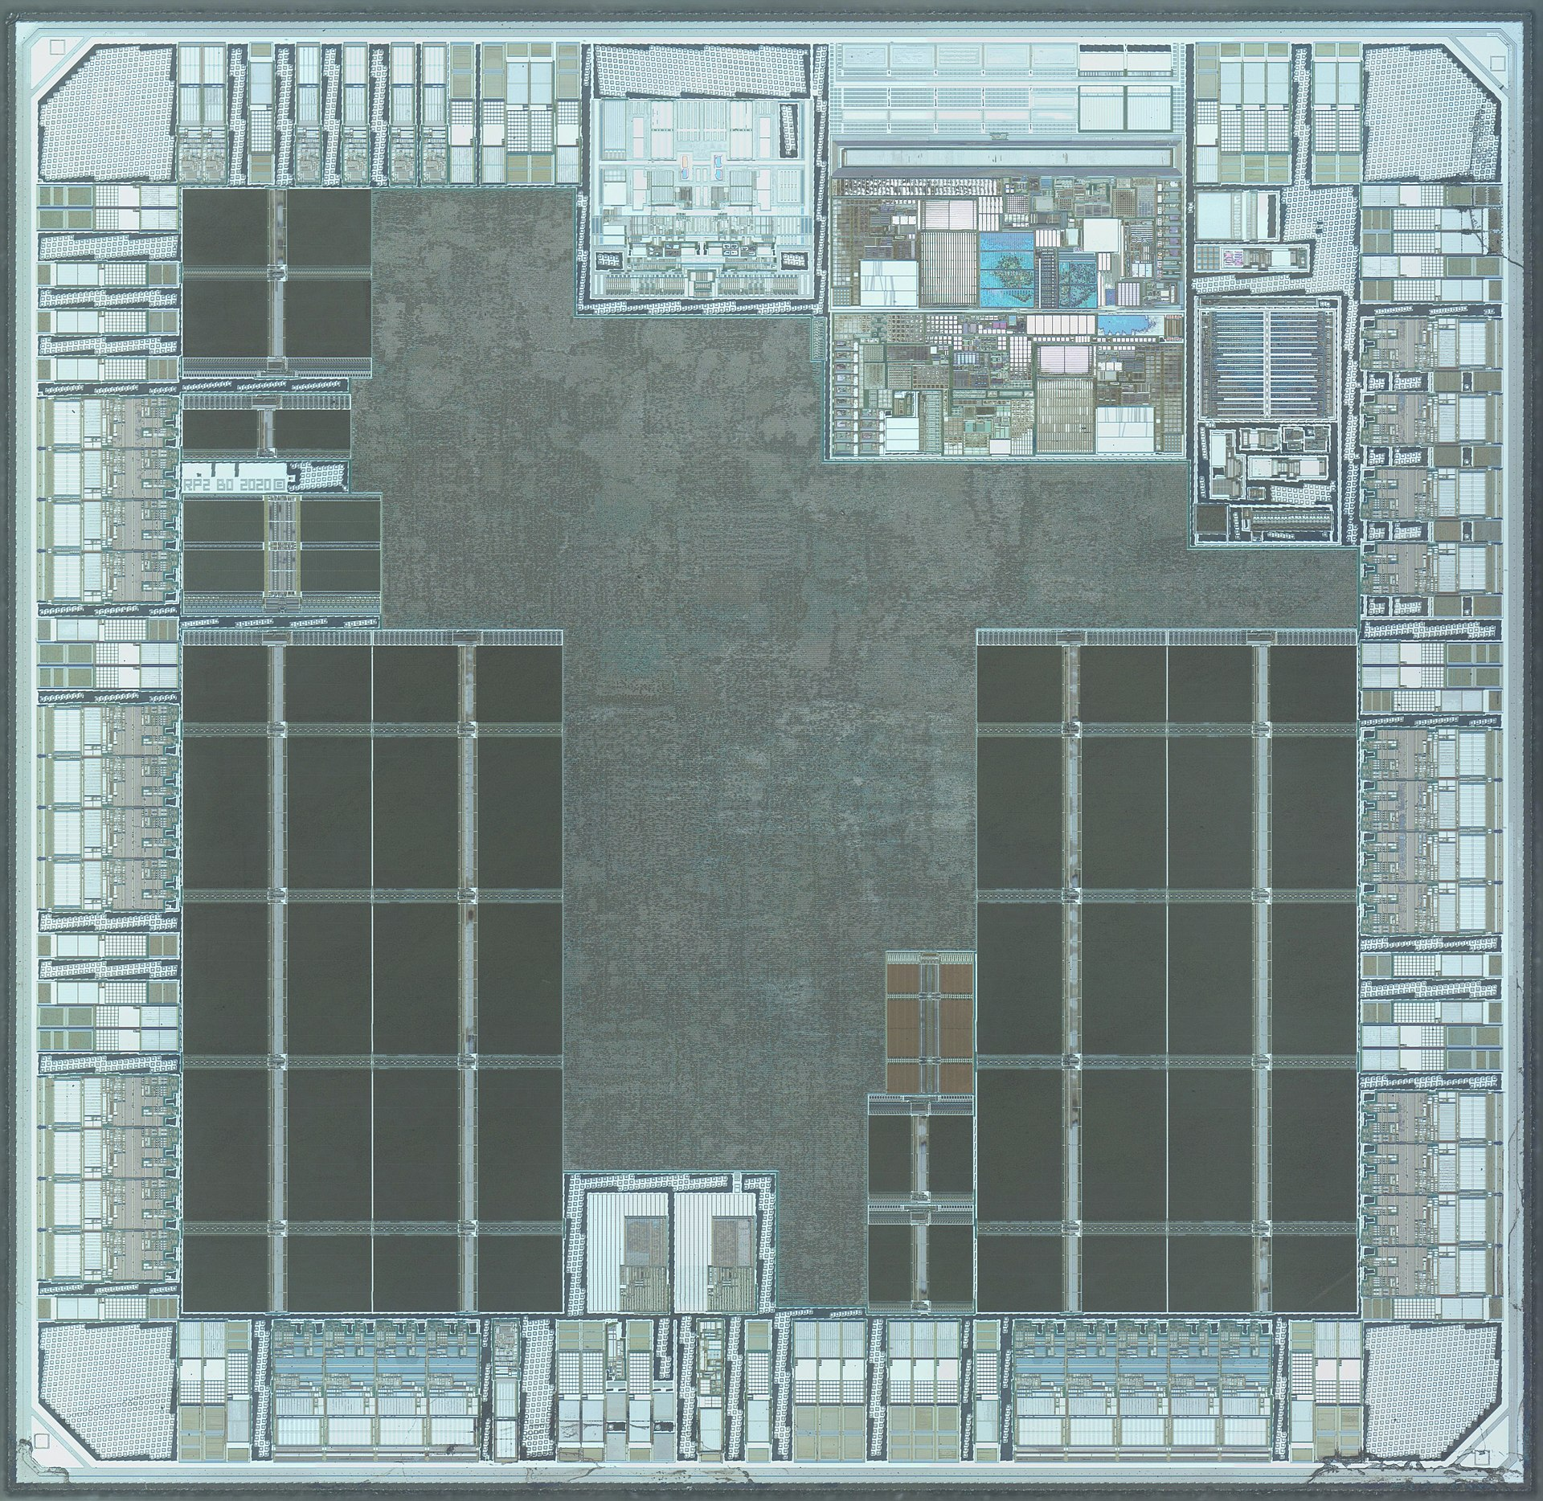
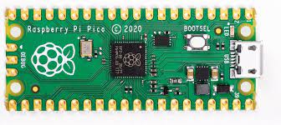
Raspberry Pi Pico: Multiple cores, Low-power

Slide 75
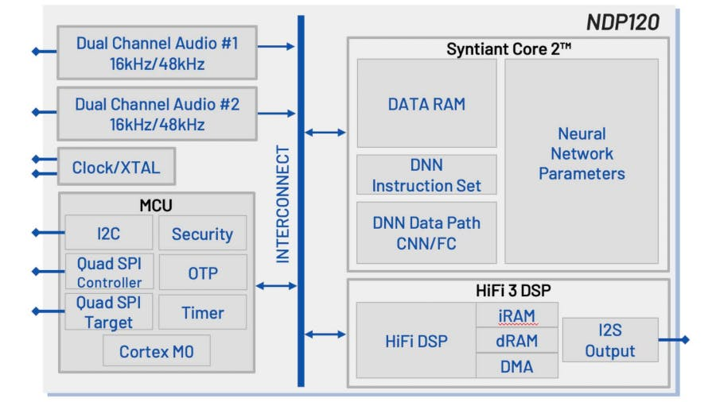
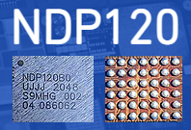
Microcontrollers with neural networks
Very low-power for specific tasks. Voice detection at hundreds of microwatts of power consumption

Slide 76
Memory on microcontroller (hierarchy)
Registers
RAM
ROM

Slide 77
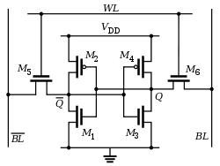
Example of volatile memory: SRAM
Same design as registers in traditional computer systems
No need to refresh it -> lower energy costs
Tradeoff:
More expensive
Physically larger

Slide 78
Example of non-volatile memory: Flash
Same design as SSDs and Flash drives
Memory is stored with no energy costs
Reading is lowish energy and quick
Writing is high energy and very slow
Writing also has to occur in blocks (e.g. 512 bytes)
Concern: Flash has a limited lifetime ~10,000 writes
Only writing to Flash when you load code? Essentially forever
Recording data to Flash every second? 2.8 hours

Slide 79
SRAM (RAM) versus Flash (ROM)
Size and time difference between non-volatile and volatile memory is significantly reduced from traditional computing
Non-volatile store 2-10x larger than volatile
Single-cycle RAM. Maybe two-cycles to Flash (to read)
Major difference: energy and writability
SRAM is low-energy to read and write (no refresh needed)
Flash is lowish-energy to read, but very high energy to write
Hierarchical structure is not enforced
Same address space for RAM and Flash (very different from traditional)
Run instructions right inside of Flash
Keep variables in RAM (or const variables in Flash)

Slide 80
Emerging non-volatile memories FRAM , MRAM
FRAM and MRAM are both rising protentional Flash replacements
Non-volatile
Writable at the byte level
Very high to infinite write/erase cycles
Lower energy costs for writing and reading
The two-use unrelated magnetic techniques for data storage
Starting to appear in microcontrollers
TI MSP430s have used 16 kB FRAM
Apollo4 (ARM Cortex-M4F) has 2 MB of MRAM

Slide 81



History of the Contiki operating system
Started in Sweden! Started by – Adam Dunkels
Awarded 2022 SenSys Test-of-Time Award for Protothreads (2004)
Companies and universities developing (or has contributed) Contiki OS:
SAP, Cisco, Atmel, NewAE and others
SICS, TU Munich and others

Slide 82
Contiki operating system: Hello, World!
#include “contiki.h”
#include <stdio.h>
PROCESS(hello_world_process, “hello world”); AUTOSTART_PROCESSES(&hello_world_process); PROCESS_THREAD(hello_world_process, ev, data)
{
PROCESS_BEGIN();
// initialize statements come here
printf(“Hello world!\n\r”);
while(1) {
// perform tasks here
// PROCESS_WAIT_EVENT();
}
PROCESS_END();

Slide 83
Hardware Platform: CC2650 SensorTag
Processor: ARM Cortex M3 32-bit processor, up to 48-MHz clock speed
Memory: 8KB of SRAM for Cache, 20KB of SRAM, 128KB of In-System Programmable Flash
Network: 6LoWPAN, Bluetooth Low energy, RF4CE, ZigBee
10 sensors including support for light, digital microphone, magnetic sensor, humidity, pressure, accelerometer, gyroscope, magnetometer, object temperature, and ambient temperature

Slide 85
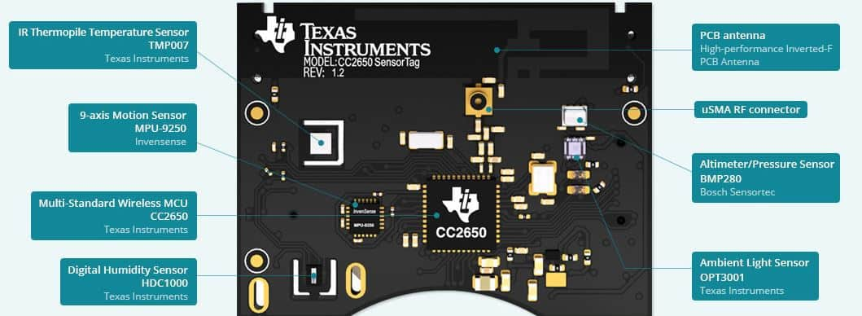

Slide 86
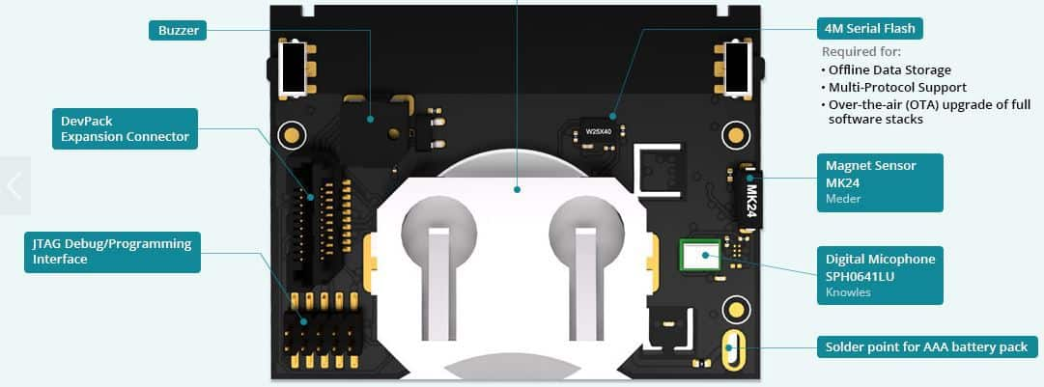

Slide 87
Wireless Networking
Ambuj Varshney
ambujv@nus.edu.sg
Notes:
++ Thank you for inviting me to give this talk
++ In this talk, I will present a pathway that can enable us to make wireless embedded systems ubiquitous. I will describe my previous research efforts that tackle the critical challenges that limit the growth of wireless embedded systems. These are related to the growing energy asymmetry that exists between sensing, computation and communication blocks on these platforms.
++ Finally, I will conclude my talk by covering the research agenda that I would like to work on as a faculty member.

